Slide 1



c.k.pithawalla college of commerce
management computer application
Project Title : DigiBankX
Guide:-
Dr. Ami Desai
Submited By:-
Jenil Dhola(7298)
Darshan Lakhani (7312)
Utsav Chheta(7294) Harsh Lakhani(7313)

Slide 2



Introduction
Project profile
project introduction
Environmental Description
Hardware & Software Requirements
Tools & Technology
Existing System
Proposed System
Scope
Expected Advantages
UML Diagrams
Use Case Diagram
System Diagrams
Table Structure
Screen Layout
Contents

Slide 3


Introduction
project profile
project introduction

Slide 4


Project Profile
PROJECT TITLE:-DigiBankX
PROJECT TYPE:- Internet Banking Management
PROJECT OBJECTIVE:-to provide platform for banking service online.
PROJRCT GUIDE:-DR.AMI DESAI
FRONT-END:-PHP 8.4.2
BACK-END:-MYSQL
SUBMITTED BY:- 1.Jenil Dhola(7298) 2.Darshan Lakhani(7312)
3.Utsav Chheta(7294)
4.Harsh Lakhani(7313)

Slide 5
Project Introduction
”DigiBankX” is The Internet Banking Management System is an online banking platform designed to provide customers with a secure, user-friendly, and efficient way to manage their banking needs remotely. This system allows users to access their accounts, perform transactions, view statements, manage loans, pay bills, and more, all through a secure and interactive online portal.
This platform is aimed at both individual customers who wish to manage their finances conveniently and bank administrators who need to oversee and manage transactions and account activities in real-time. With robust security measures in place, the system ensures that users’ data and financial transactions are protected from unauthorized access.

Slide 6

Environmental Description
1.HARDWARE & SOFTWARE REQUIREMENT
2.TOOLS & TECHNOLOGY

Slide 7



hardware & software Requirement
Client Side :
- Internet enabled devices with Web Browser
Server Side :-
- Xamp Server(8.0.3)
Disk Space (1 GB)
Development Side :
Processor (Intel CORE i5 11th gen)
O.S (Windows 11 Pro)
Memory (16 GB)
Hard Disk (500 GB)
Web Browser : Developed in Google Chrome(Tested in Google Chrome)

Slide 8
Documentation tools
Development tools
visual studio code
MS WORD
MS POWER POINT
tools

Slide 9

technology
Core technology
Extra technology
PHP
MYSQL
Java script
AJAX
JQUERY

Slide 10
EXISTING SYSTEM
Traditional Banking Challenges – Limited banking hours, long queues, and manual errors.
Current Internet Banking – Provides online portals and mobile apps for fund transfers, bill payments, and account management.
Limitations – Security risks, complex user interfaces, and lack of third-party integrations.
Need for Improvement – A more secure, user-friendly, and feature-rich solution like DigiBankX.

Slide 11
Proposed System
Aim & objectives
Scope
Expected Advantages

Slide 12
AIM & OBJECTIVES
Provide a seamless and efficient banking experience.
Enable customers to easily access available banking services.
Help customers manage transactions effectively.
Enhance overall customer satisfaction.
Offer advanced banking management solutions.

Slide 13
AIM & OBJECTIVES
Ensure secure and reliable online banking operations.
Simplify the loan application and approval process.
Provide real-time account tracking and management.
Offer user-friendly interfaces for both staff and clients.
Present financial data and account types in graphical reports.

Slide 14
Scope
SCOPE
ADMIN
STAFF
USERS
VISITOR

Slide 15

Admin
Admin can do following tasks:-
Dashboard Overview – View key banking statistics, transactions, and user activities in one place.
Admin Profile Management – Update personal details, change passwords, and manage login credentials.
Staff Management – Add new staff, edit details, enable/disable accounts, and remove staff when needed.
Client Management – Manage customer profiles, update details, and handle banking services.
Account Management – Add different account types and oversee new account openings.

Slide 16
Admin
Loan Management – Review loan applications, approve/reject requests, and manage loan categories.
Balance Inquiry – Check customer account balances and provide quick financial insights.
Financial Reports – Monitor deposits, withdrawals, and transfers for banking transparency.
System Settings – Configure system preferences, update features, and ensure smooth operations

Slide 17
Staff
staff can do following tasks:-
Dashboard Overview – Access key banking activities and quick insights.
Profile Management – Update personal details and login credentials.
Client Management – Handle customer profiles and banking services.
Account Opening – Assist in creating and managing new accounts.
Financial Transactions – Process deposits, withdrawals, and fund transfers.

Slide 18
Staff
Loan Management – Recommend loan applications to the admin for approval.
Balance Inquiry – Check customer account balances in real-time.
Transaction History – View and roll back transactions if necessary.
Financial Reports – Generate reports on deposits, withdrawals, and transfers.
Complaint Management – View and address customer complaints.

Slide 19
User
User can do following tasks:-
Dashboard Overview – View account details, transactions, and banking updates.
Profile Management – Update personal information and security settings.
Account Management – Open new accounts and manage existing ones.
Financial Transactions – Deposit, withdraw funds, and apply for loans.
Balance Inquiry – Check account balance anytime, anywhere.

Slide 20
User
User can do following tasks:-
Nominee Management – Add and update nominee details for accounts.
EMI Installments – Track and pay loan EMIs conveniently.
Transaction History – View past transactions for better financial tracking.
Complaint Management – Lodge and track complaints for banking issues.

Slide 21

EXPECTED ADVANTAGES
Enhanced Efficiency – Automates banking operations, reducing manual workload.
Improved Security – Implements strong authentication and data encryption for safety.
Better User Management – Allows seamless handling of staff, clients, and account types.
Faster Loan Processing – Streamlines loan application reviews and approvals.
Real-time Financial Reports – Provides instant insights into deposits, withdrawals, and transfers.
Simplified Account Management – Easy tracking and handling of account openings and inquiries.
Customizable System Settings – Enables smooth updates and system enhancements.
Increased Customer Satisfaction – Ensures faster banking services and better user experience.

Slide 22
Uml Diagram
Use case diagrams

Slide 23
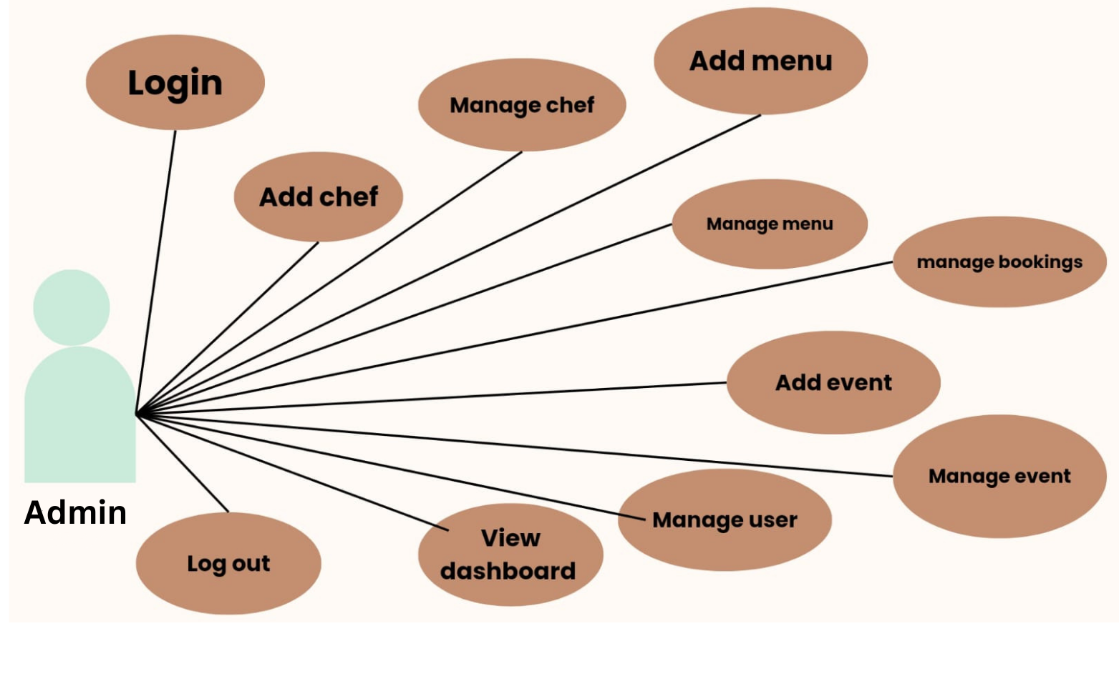

manage staff
manage client
add a/c type
add staff
manage account
dashbord
manage a/c type
login
manage a/c opening
review loan application
add loan type
Admin
manage loan types
log out
manage system settings
print finacial report
roll back transactions
balance enquiries

Slide 24
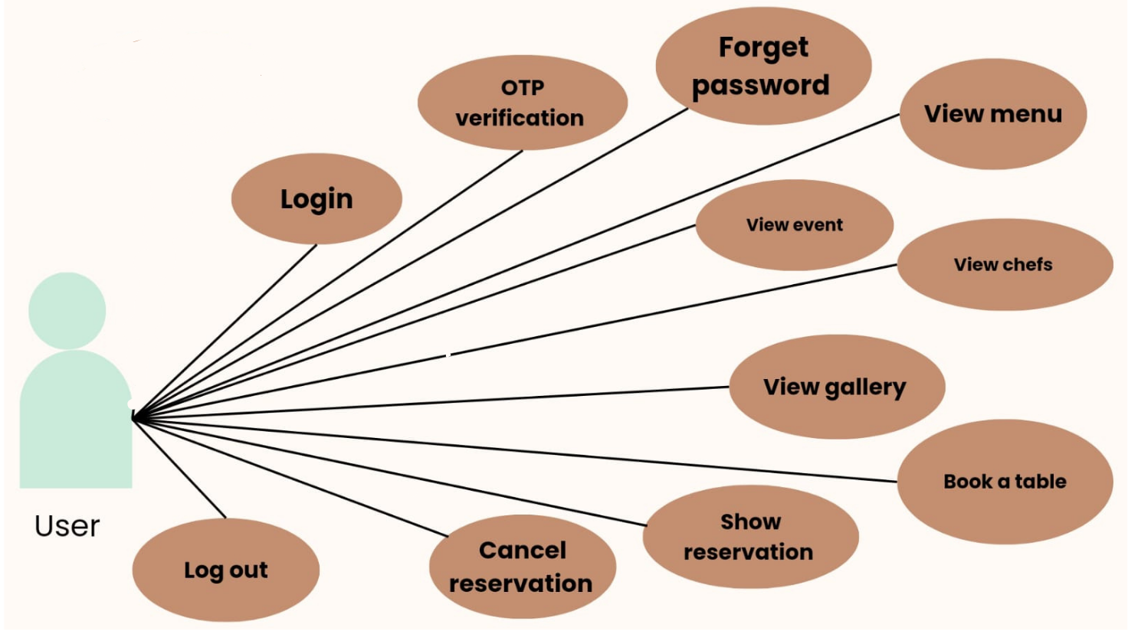
manage account opening
deposite money
manage client
withdraw money
manage profile
dashbord
transfer money
login
review loan application
balance enquiries
roll back transations
Staff
view finacial
view complians
print finacial report
log out

Slide 25
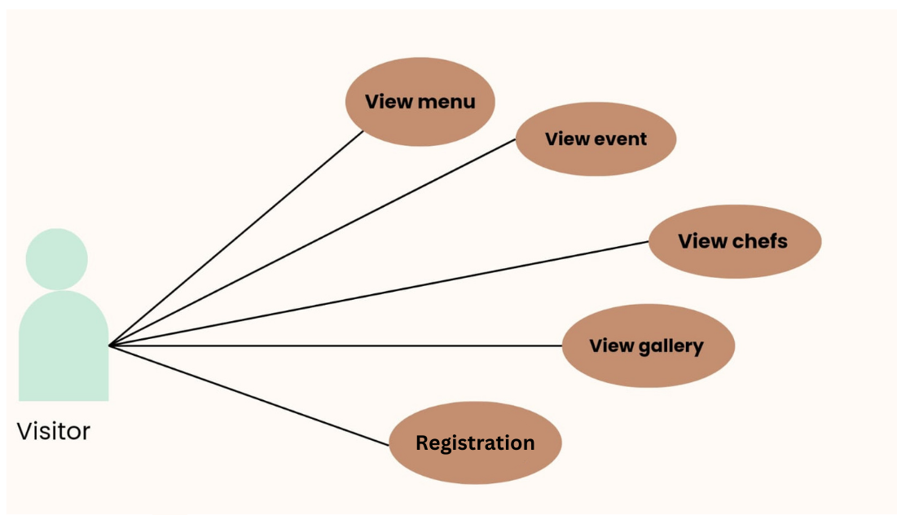
open account
view account
Registration
manage profile
deposite money
dashbord
log in
withdraw money
transfer money
apply loan
view loan status
User
log out
balance enquiries
complians
transaction history
EMI installation
view nominee
add nominee

Slide 26
Table Name: client_feedback Use: It is used to store the information of client_feedback.
Field | Type | Constraints | Description
ID | int(10) | Primary Key (AutoIncrement) | Unique field.
client_id | Int(10) | foreign key | Unique field.
subject | varchar(255) | Not Null | Specify subject
feedback_message | text | Not Null | Specify feedback
Submission_date | Timestamp | Current Timestamp | Specify Contact Number.

Slide 27
Table Name : ib_acc_types
Use : It is used to store the information of a/c types.
Field | Type | Constraints | Description
acctype_id | int(10) | Primary Key (AutoIncrement) | Unique field.
Name | varchar(200) | Not Null | Specify Name.
discription | Longtext | Not null | Specify description
Rate | Varchar(200) | Not null | Specify rate
Is_active | Tinyint(1) | Not null | Specify active
Min_balance | Decimal(10,2) | Not null | Specify minimum balance

Slide 28
Table Name : ib_admin
Use : It is used to store the information of admin.
Field | Type | Constraints | Description
Admin_id | int(11) | Primary Key (AutoIncrement) | Unique field.
Name | varchar(200) | Not Null | Specify Name.
email | varchar(200) | Not null | Specify email
password | varchar(200) | Not null | Specify password
profile_pic | varchar(200) | Not null | Specify profile picture
Is_active | Tinyint(1) | Not null | Specify active
otp | Varchar(6) | allows null | Specify otp
Otp_expiry | Date_time | Allows null | Specify otp expiry

Slide 29
Table Name : ib_bankaccounts
Use : It is used to store the information of bankaccounts .
Field | Type | Constraints | Description
account_id | int(11) | Primary Key (AutoIncrement) | Unique field.
Acc_Name | varchar(200) | Not Null | Specify a/c Name.
account_number | varchar(200) | Not null | Specify a/c number
Acc_type | varchar(200) | Not null | Specify acc type
Acc_rate | varchar(200) | Not null | Specify acc rate
Acc_status | varchar(200) | Not null | Specify acc status
Acc_amount | varchar(200) | Not null | Specify a/c amount
client_id | int(10) | allows null | Specify client id
Created-at | timestamp | not null | Specify created-at
Is_active | Tinyint(1) | Not null | Specify active

Slide 30
Table Name : ib_clients
Use : It is used to store the information of clients.
Field | Type | Constraints | Description
client_id | int(11) | Primary Key (AutoIncrement) | Unique field.
Name | varchar(200) | Not Null | Specify Name.
phone | varchar(200) | Not null | Specify phone
Adress | varchar(200) | Not null | Specify adress
Email | varchar(200) | Not null | Specify email
Adhar_number | varchar(200) | Not null | Specify adhar_number
Pan_number | varchar(200) | Not null | Specify pan_number
password | varchar(200) | Not null | Specify password
Profile_pic | Varchar(200) | not null | Specify profile picture
Is_active | Tinyint(1) | Not null | Specify active
otp | Varchar(6) | allows null | Specify otp
Otp_expiry | Datetime | Allows null | Specify otp expiry

Slide 31
Table Name : ib_nominees
Use : It is used to store the information of nominees .
Field | Type | Constraints | Description
id | int(11) | Primary Key (AutoIncrement) | Unique field.
client_id | int(11) | Not null | Specify client id.
Nominee_Name | varchar(200) | Not Null | Specify nominee Name.
Relation | varchar(200) | Not null | Specify
Nominee_Email | varchar(200) | Not null | Specify nominee email
Nominee_phone | varchar(200) | Not null | Specify Nominee_phone
Nominee_Adress | varchar(200) | Not null | Specify Nominee_adress
Is_active | Tinyint(1) | Not null | Specify active
Adhar_number | varchar(12) | Not null | Specify adhar_number
Pan_number | varchar(10) | Not null | Specify pan_number

Slide 32
Table Name :ib_staff
Use : It is used to store the information of .
Field | Type | Constraints | Description
staff_id | int(11) | Primary Key (AutoIncrement) | Unique field.
Name | varchar(200) | Not Null | Specify Name.
phone | varchar(200) | Not null | Specify phone
Email | varchar(200) | Not null | Specify email
password | varchar(200) | Not null | Specify password
Sex | varchar(200) | Not null | Specify sex
Profile_pic | Varchar(200) | not null | Specify profile picture
otp | Varchar(6) | allows null | Specify otp
Otp_expiry | Datetime | Allows null | Specify otp expiry
Adhar_number | varchar(12) | Not null | Specify adhar_number
Pan | varchar(10) | Not null | Specify pan_number

Slide 33
Table Name :ib_systemsetting
Use : It is used to store the information of systemsettin
Field | Type | Constraints | Description
Id | int(11) | Primary Key (AutoIncrement) | Unique field.
Sys_Name | longtext | Not Null | Specify name.
Sys_lageline | longtext | Not null | Specify tageline
Sys_logo | Varchar(200) | Not null | Specify logo
Is_active | Tinyint(1) | Not null | Specify active

Slide 34
Table Name :ib_transaction
Use : It is used to store the information of transaction .
Field | Type | Constraints | Description
tr_id | int(11) | Primary Key (AutoIncrement) | Unique field.
code | Varchar(200) | Not null | Specify code
account_id | int(11) | foreign keyclienbt | Specify account id
Tr_type | Varchar(200) | Not null | Specify type
Tr_status | Varchar(200) | Not null | Specify status
client_id | Int(10) | foreign key | Unique field.
transaction_amt | Varchar(200) | Not null | Specify transaction amt
receiving_acc_no | Varchar(200) | Not null | Specify receiving acc no
Created-at | timestamp | not null | Specify created-at
Is_active | Tinyint(1) | Not null | Specify active

Slide 35
Table Name :ib_loan_applicant
Use : It is used to store the information of applicant.
Field |  | Type | Constraints | Description
id |  | int(10) | Primary Key (AutoIncrement) | Unique field.
loan_amount |  | decimal(10,2) | foreign keyclient | Specify account id
Application_date |  | datetime | Not null | Specify type
status |  | enum | Not null | Specify status
Reviewed_by |  | Int(11) | foreign key | Unique field.
admin_review_id |  | Int(11) | Not null | Specify transaction amt
Review_date |  | datetime | Not null | Specify receiving acc no
Staff_remark |  | text | not null | Specify created-at
admin_remark |  | text | Not null | Specify active
Client_id |  | Int(10) | None | Specify cid
Loan_type_id |  | Int(11) | Null | Specify loan_type_id
is_approved_by_staff |  | Tinyint(1) | None | Specify staff
income_salary |  | Decimal(10,2) | None | Specify income
loan_duration_years |  | Int(11) | None | Specify loan
loan_duration_months |  | Int(11) | none | Specify duration

Slide 36
Table Name : loan_payments
Use : It is used to store the information of loan_payments .
Field | Type | Constraints | Description
id | int(10) | Primary Key (AutoIncrement) | Unique field.
Client_id | int(10) | Not null | Specify client id
loan_id | int(10) | foreign keyclient | Specify loan id
emi_date | date | Not null | Specify emi date
amount | Decimal(10.2 | Not null | Specify amount
status | enum | foreign key | Specify status.
Created_at | timestamp | Not null | Specify created at

Slide 37
Table Name : loan_types
Use : It is used to store the information of loan type .
Field | Type | Constraints | Description
id | int(10) | Primary Key (AutoIncrement) | Unique field.
type_name | Varchar(100) | Not null | Specify type_name
description | text | foreign keyclient | Specify description
interest_rate | Decimal(5,2) | Not null | Specify rate
Max_amount | Decimal(15,2) | Not null | Specify amount
Created_at | Timestamp | foreign key | Unique field.
Is_active | tinyInt(11) | Not null | Specify active

Slide 38
Table Name : loan_types
Use : It is used to store the information of .
Field | Type | Constraints | Description
id | int(10) | Primary Key (AutoIncrement) | Unique field.
Admin_id | int(10) | Not null | Specify admin_id
token | Varchar(64) | foreign keyclient | Specify token
expiry | datetime | Not null | Specify expiry

Slide 39
Screen layout :

Slide 40
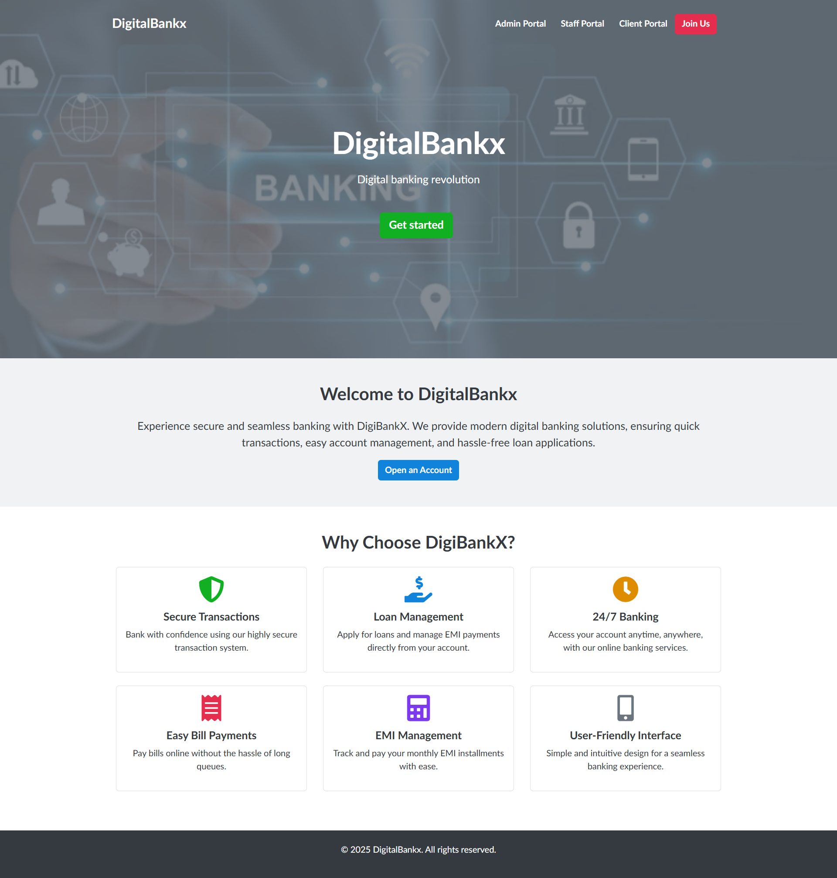
Visitor page :

Slide 41
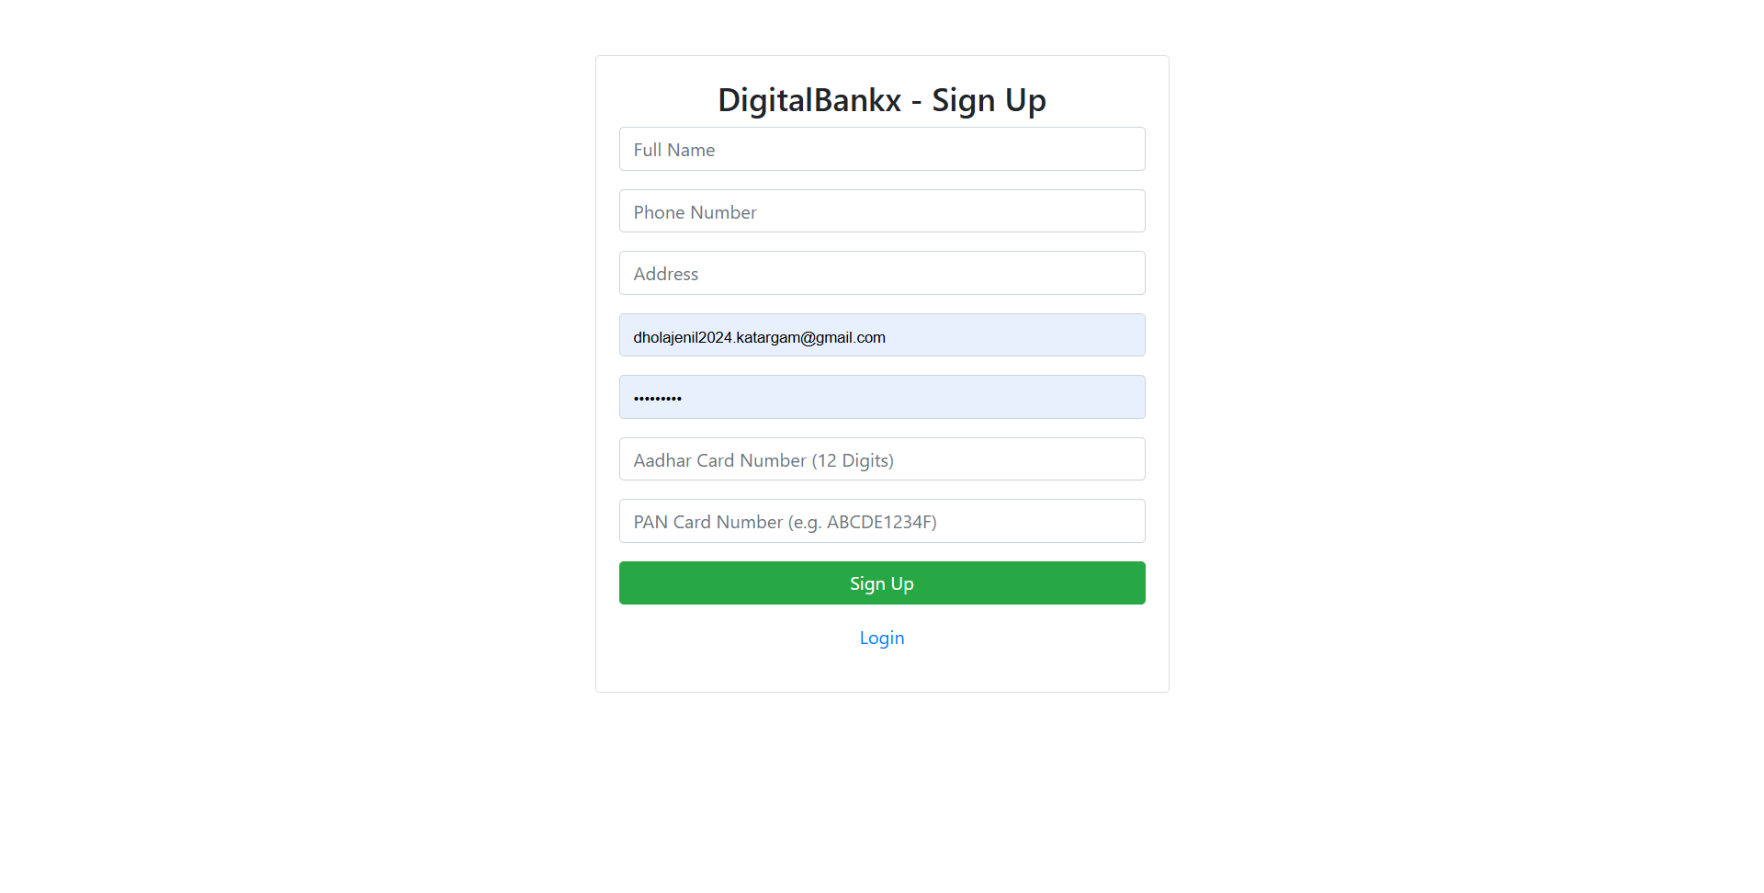
Sign up page

Slide 42
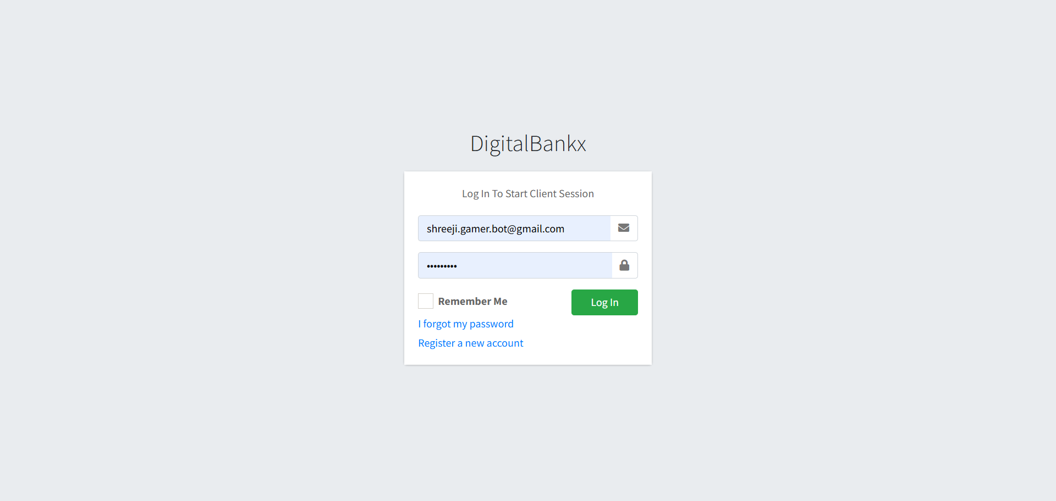
Log in page

Slide 43
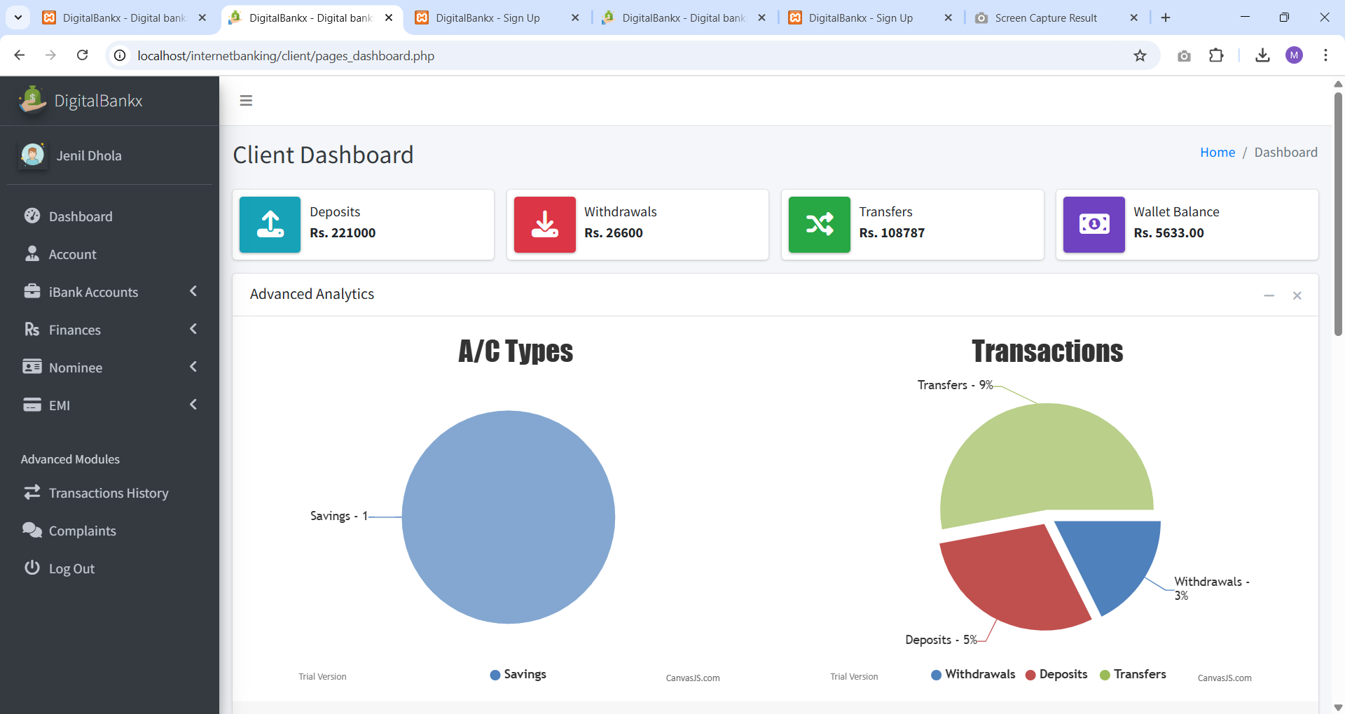
User dashbord

Slide 44
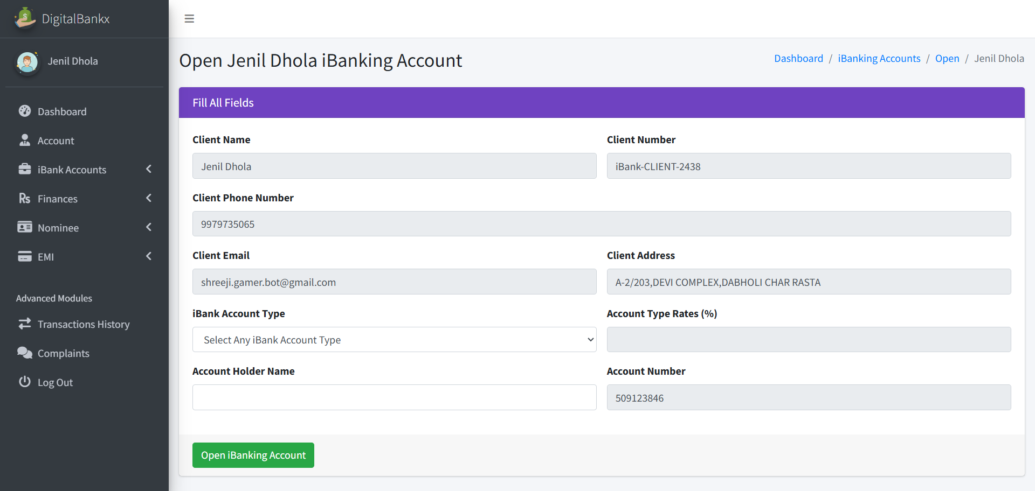
Opening account page :

Slide 45
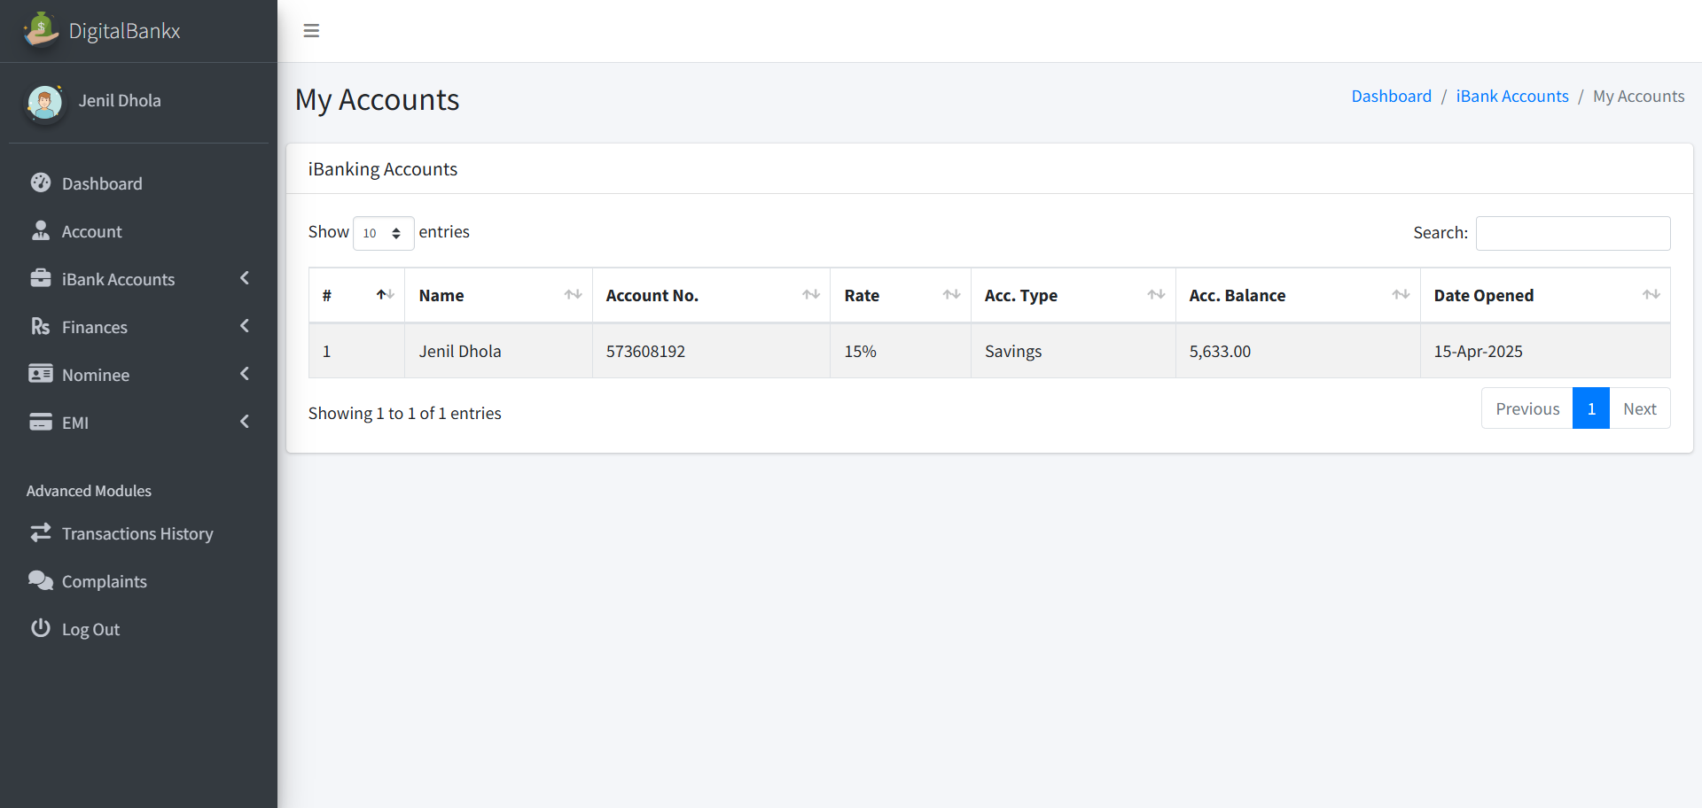
My account page :

Slide 46
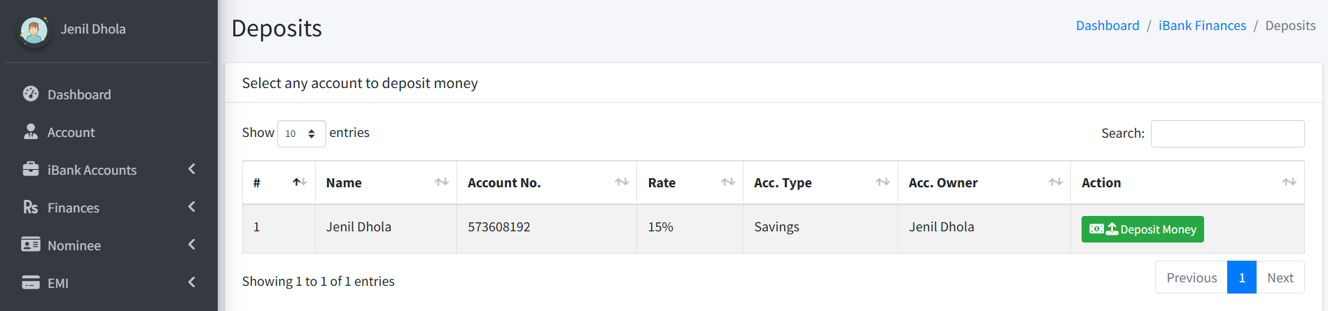
Deposite :
Transfer deposite

Slide 47

Withdrawals
Withdraw Money

Slide 48
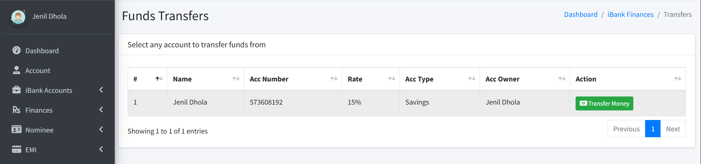
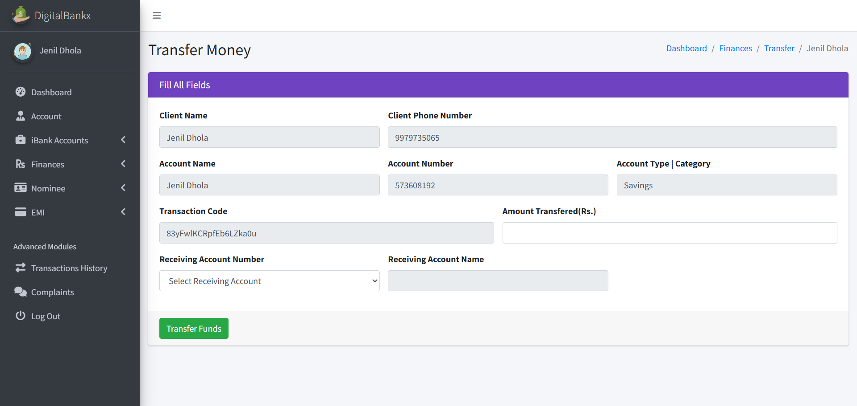
Transfer
transfer Money

Slide 49
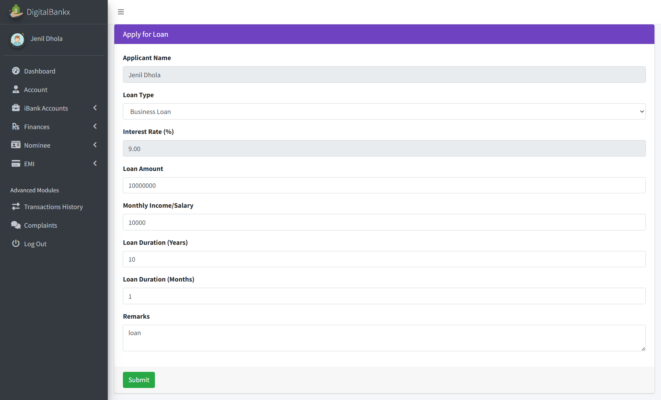
Apply for loan:

Slide 50
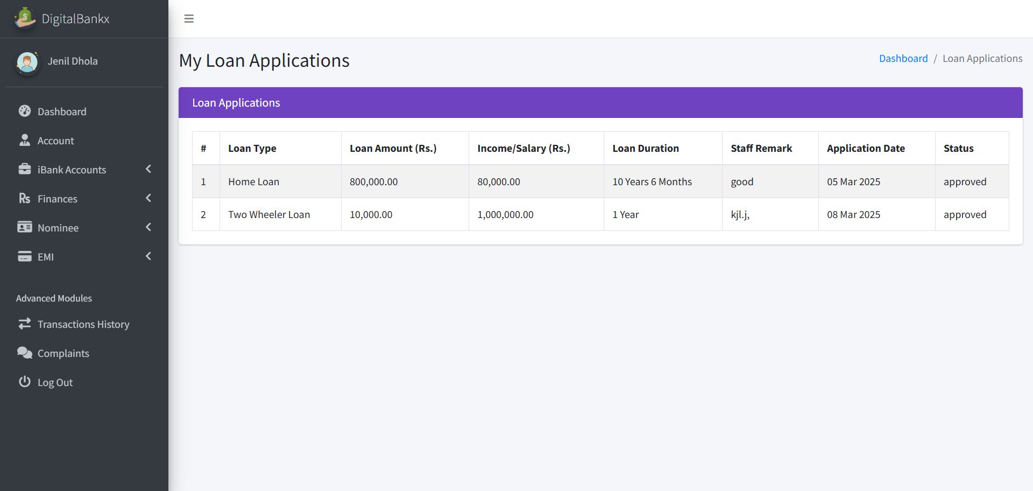
My loan application :

Slide 51
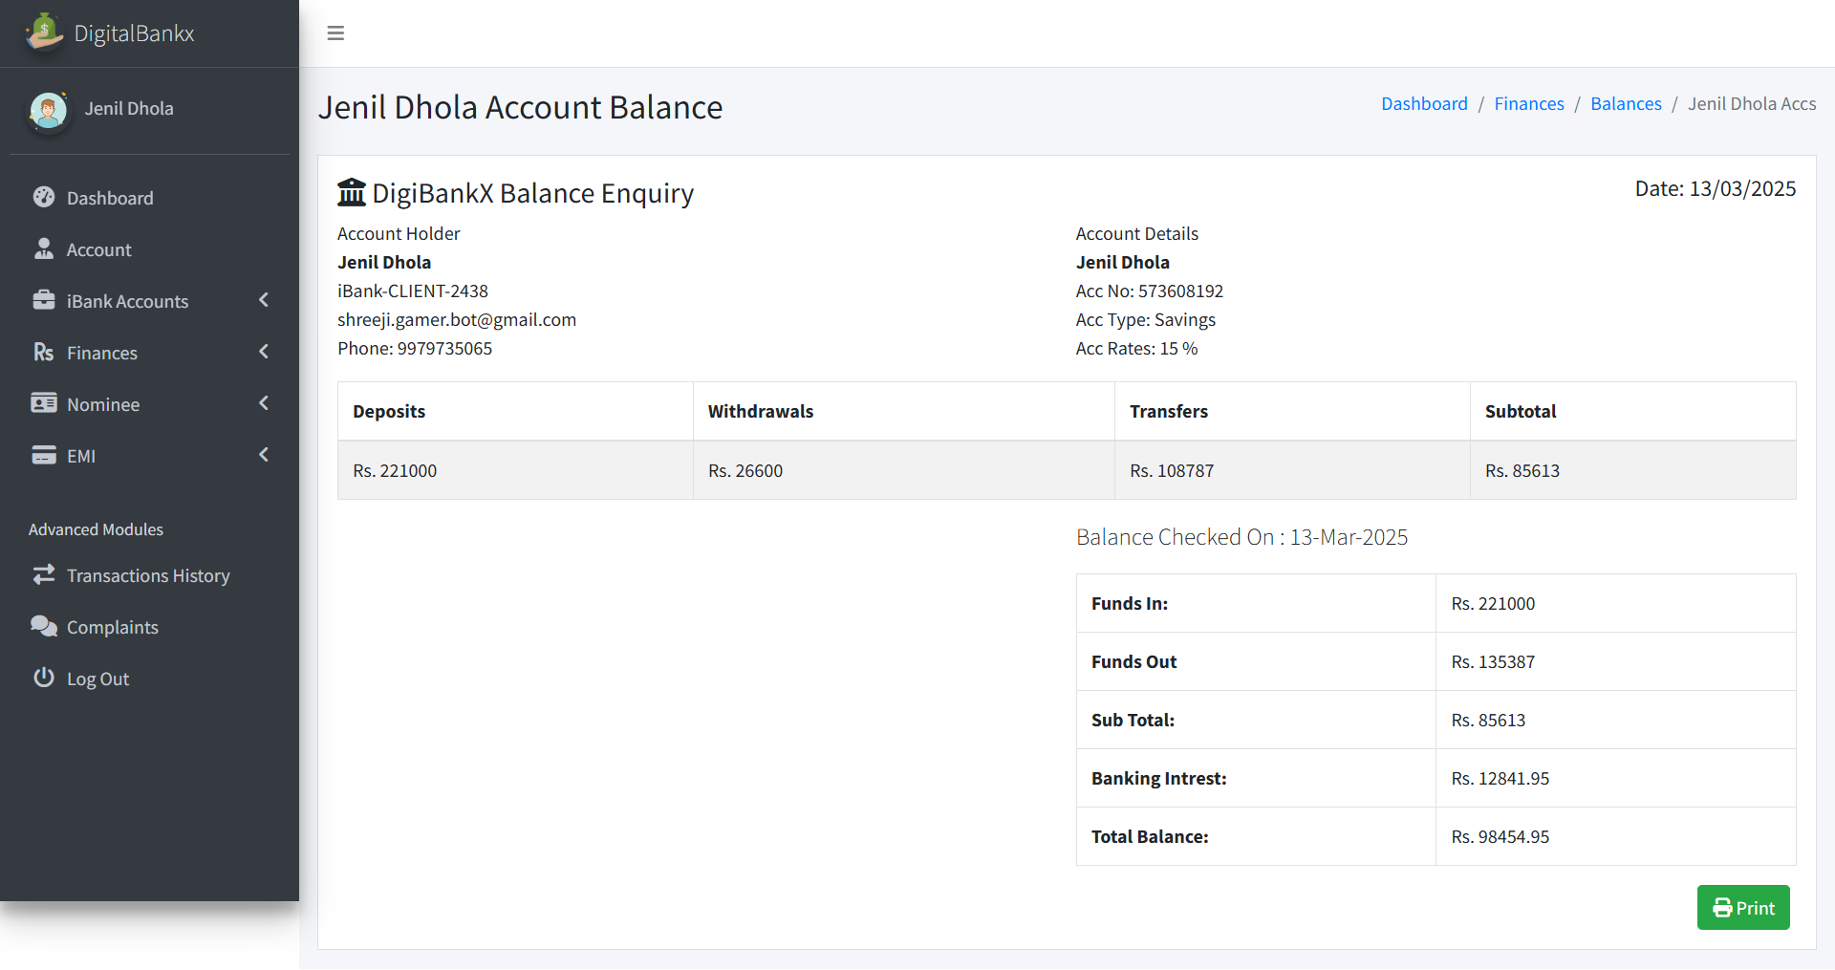
Balance enquiries :

Slide 52
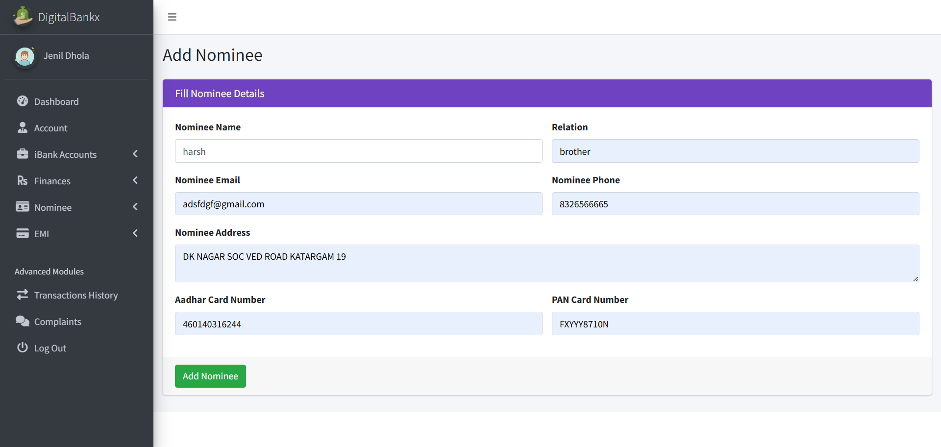
Add nominee:

Slide 53
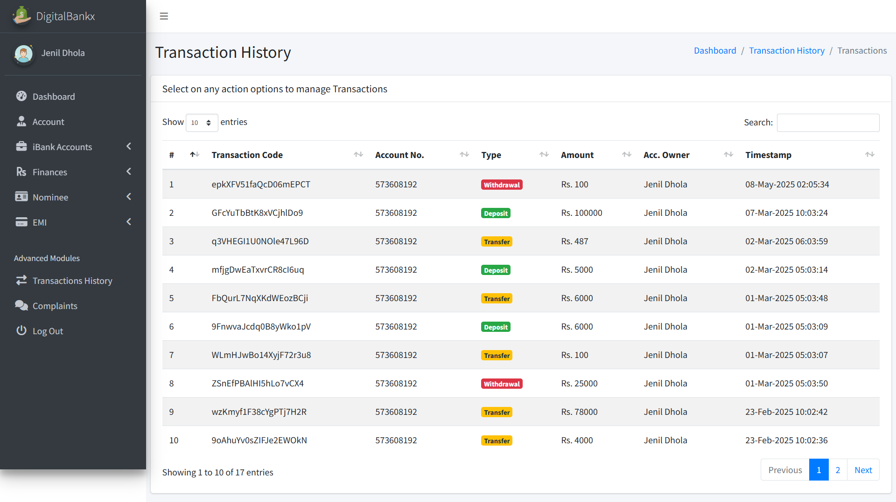
Transaction history:

Slide 54
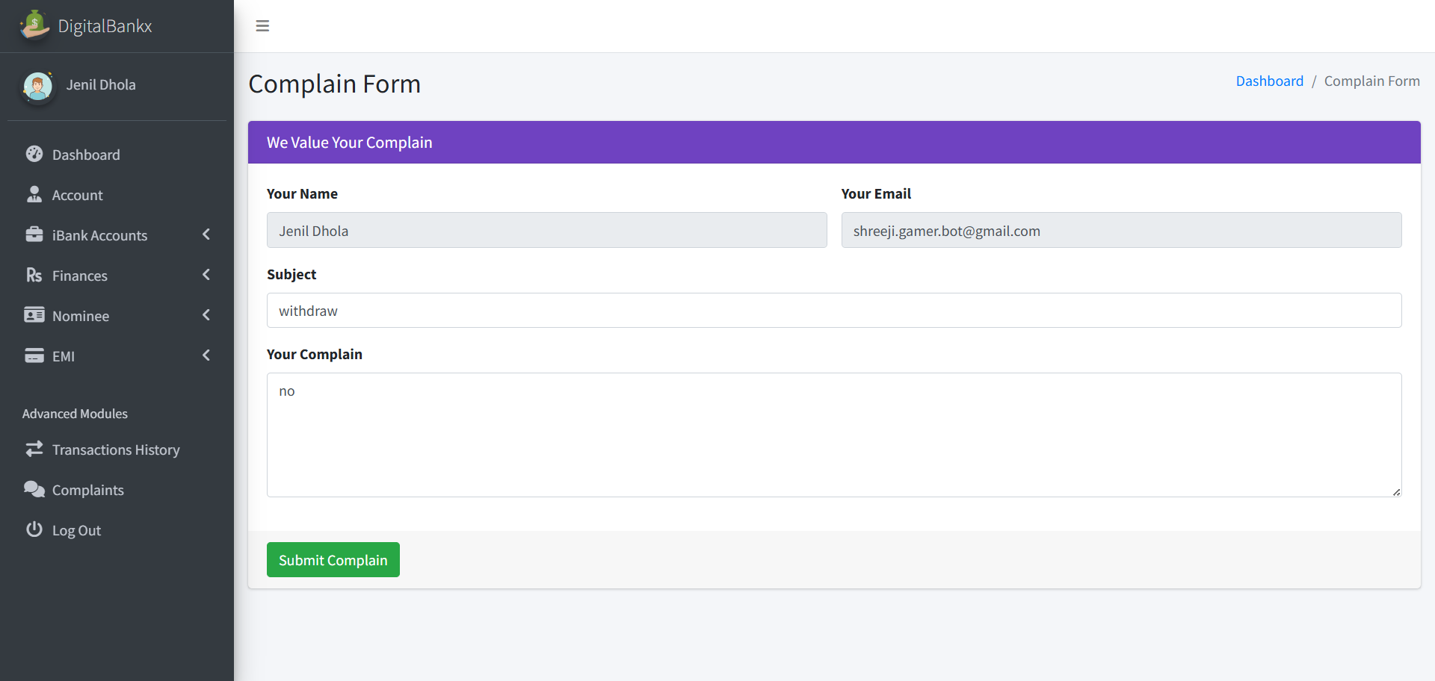
Complain :

Slide 55
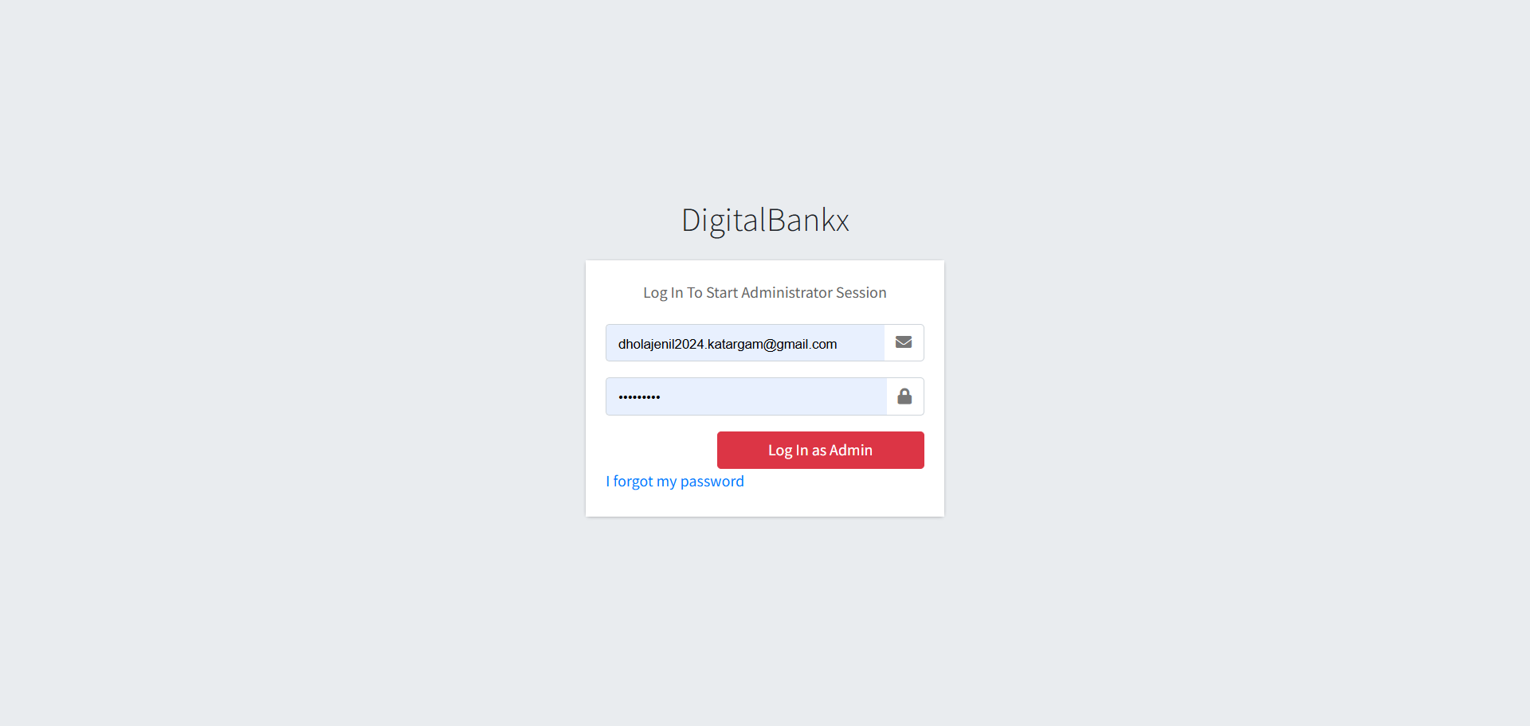
Admin login

Slide 56
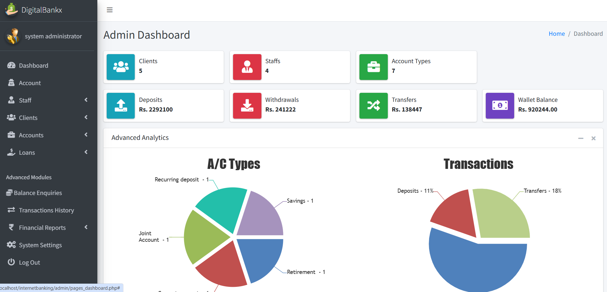
Admin dashbord

Slide 57
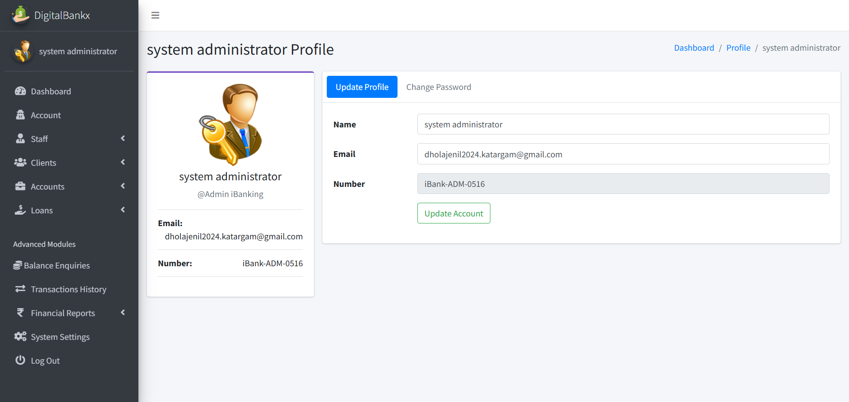
Admin update profile:

Slide 58
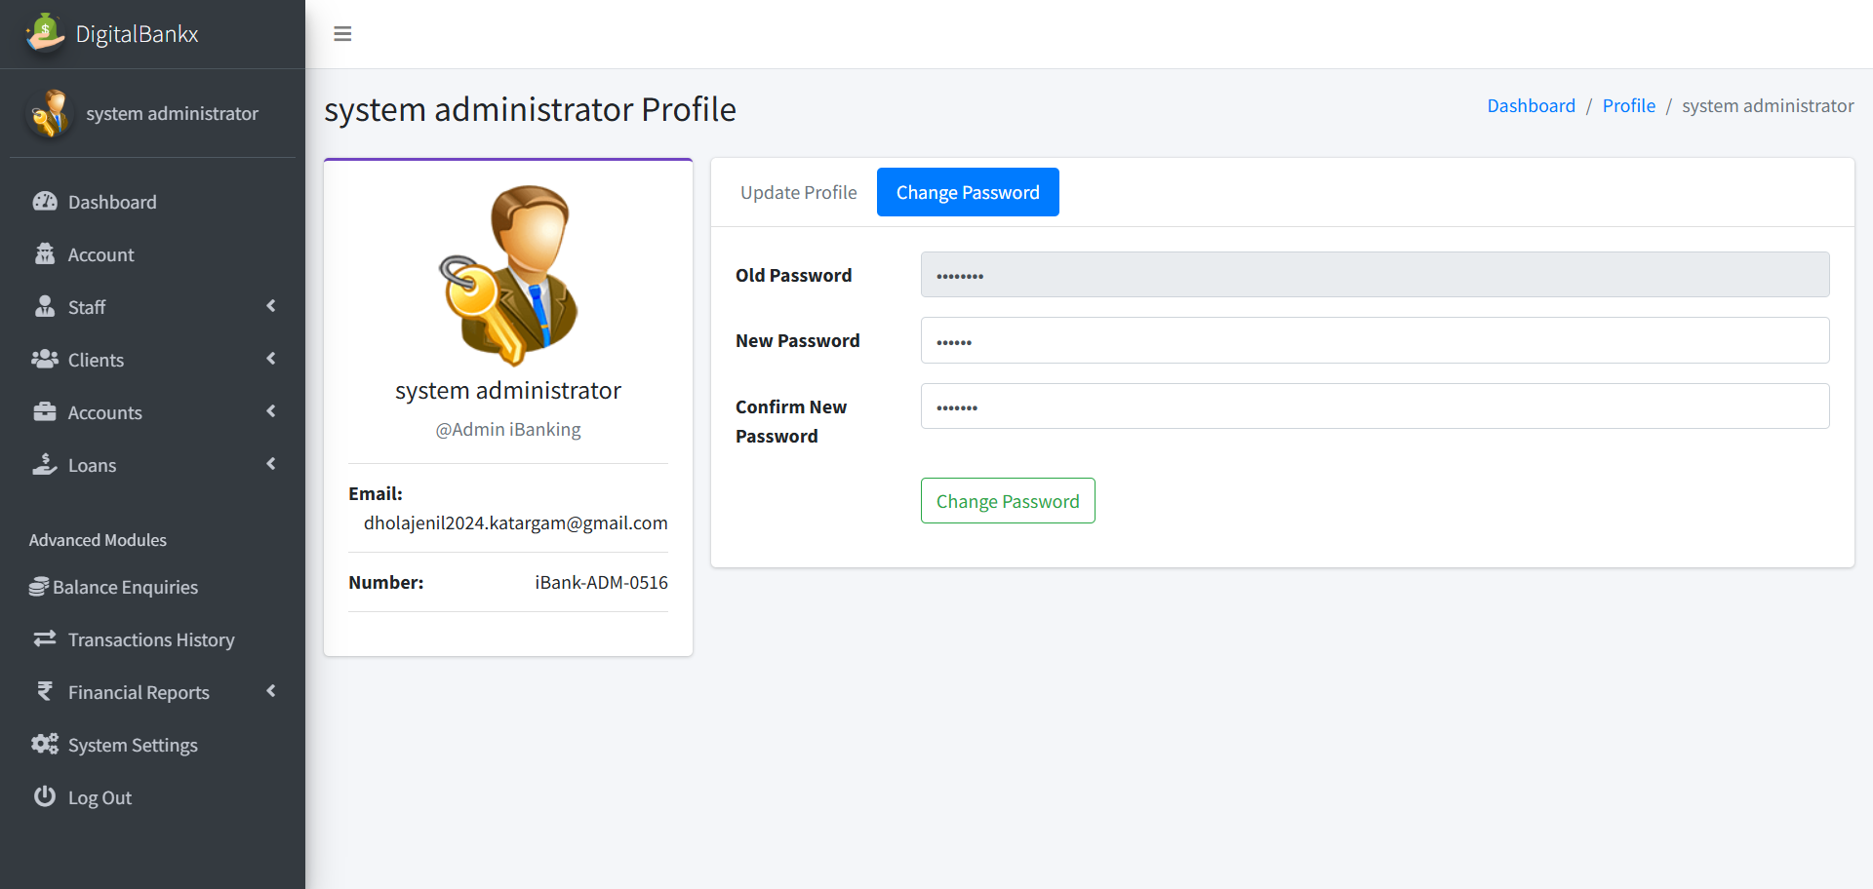
Admin change password :

Slide 59
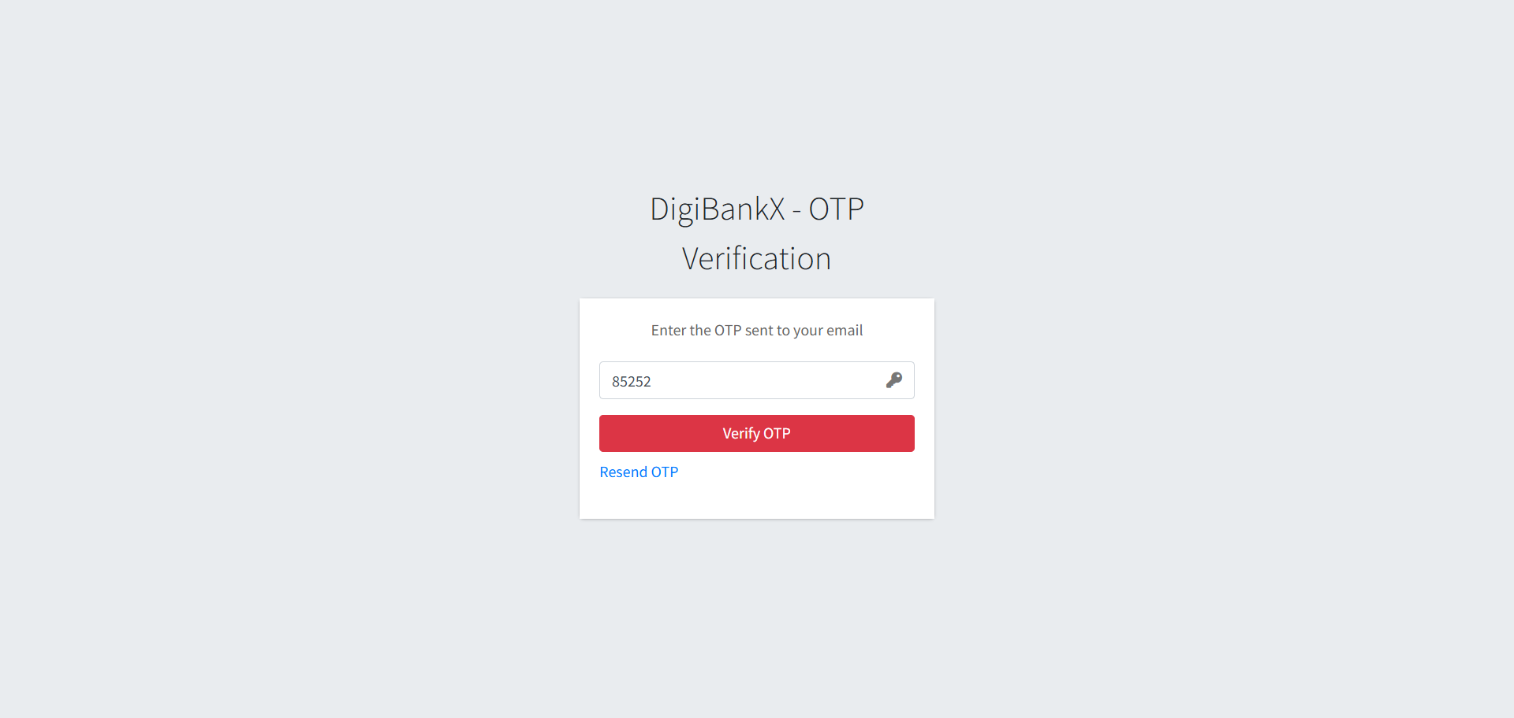
Change password OTP:

Slide 60
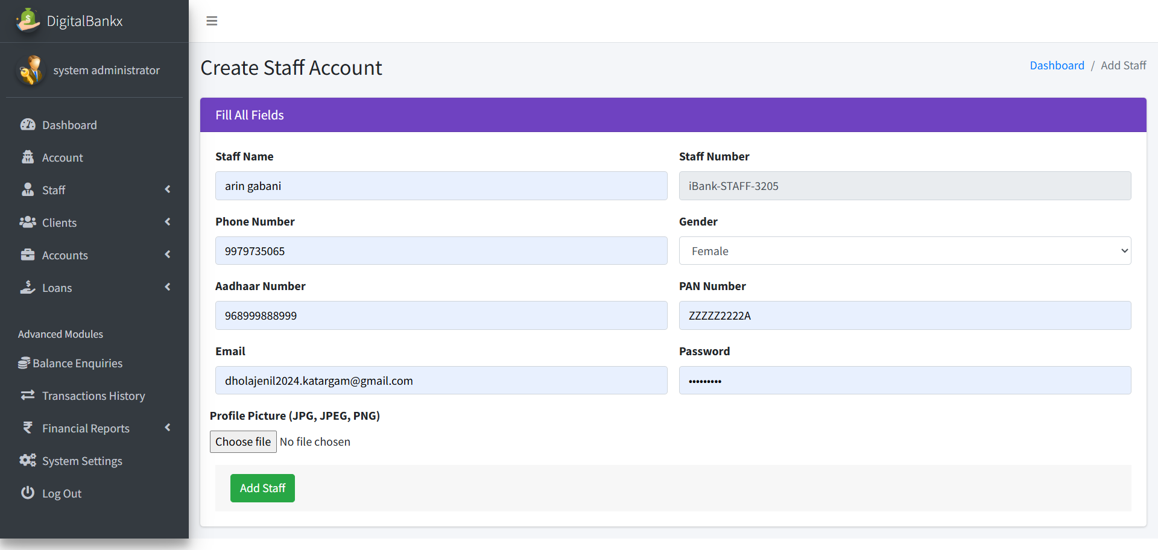
Create staff :

Slide 61
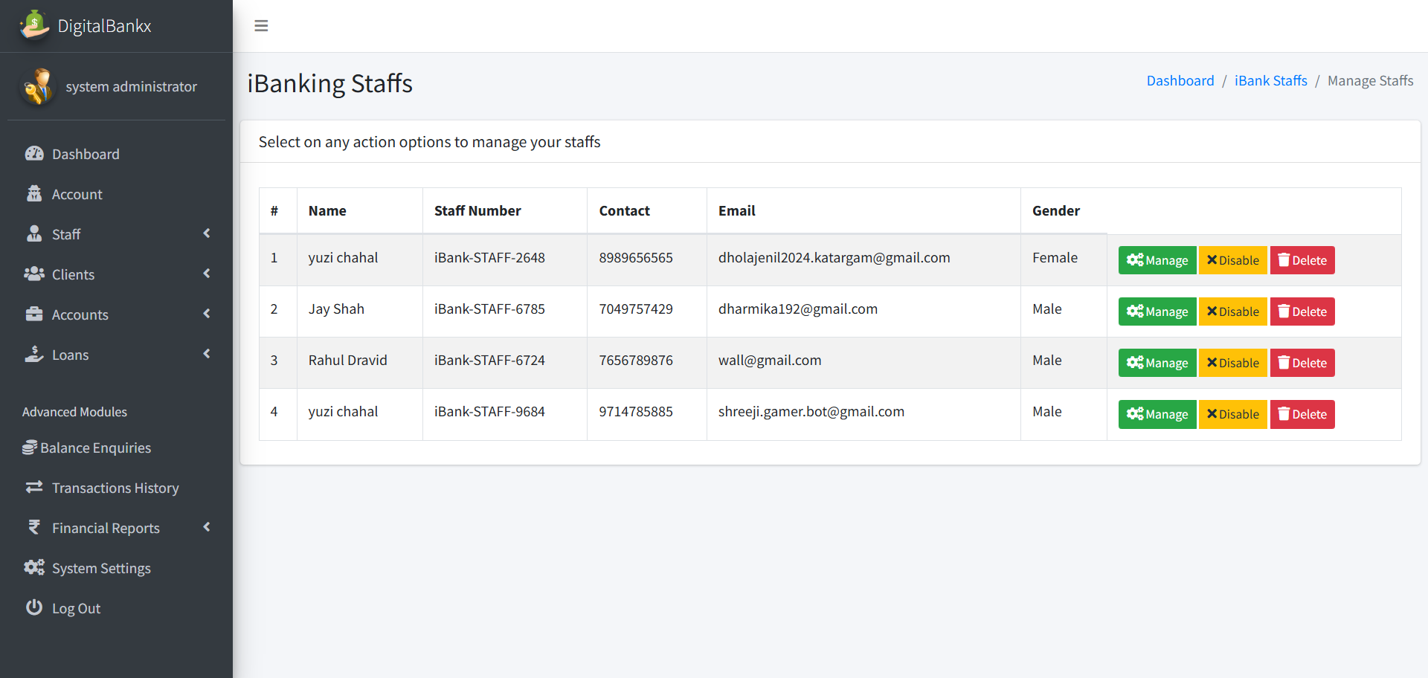
staff page:

Slide 62
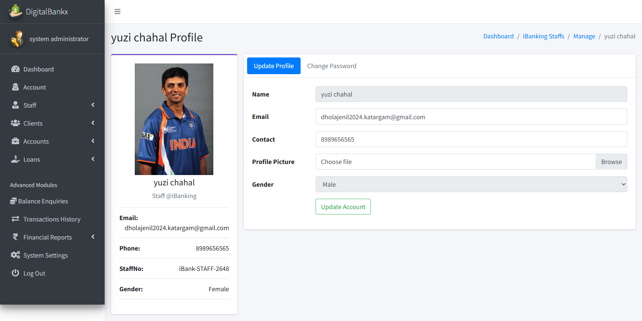
manage staff :

Slide 63
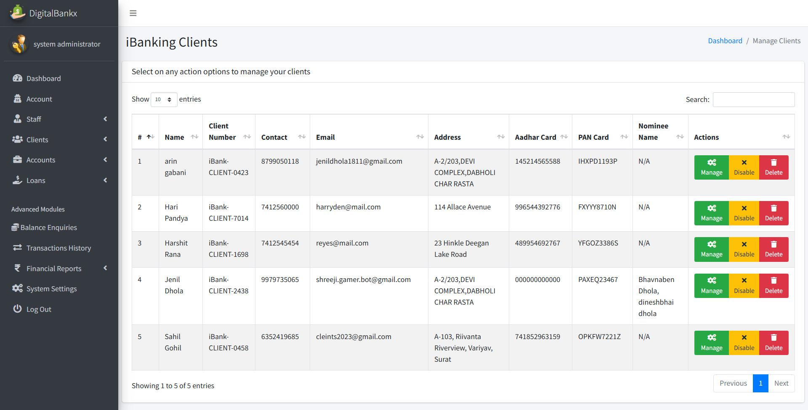
Client page :

Slide 64
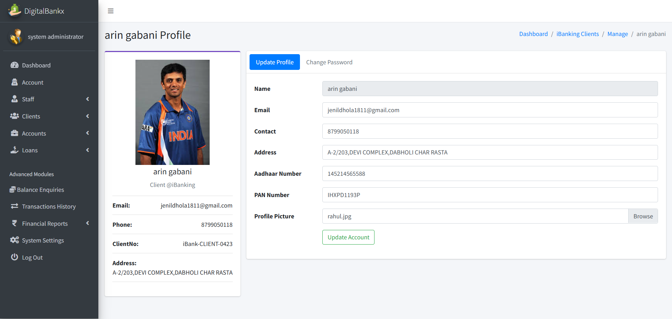
Manage clients :

Slide 65
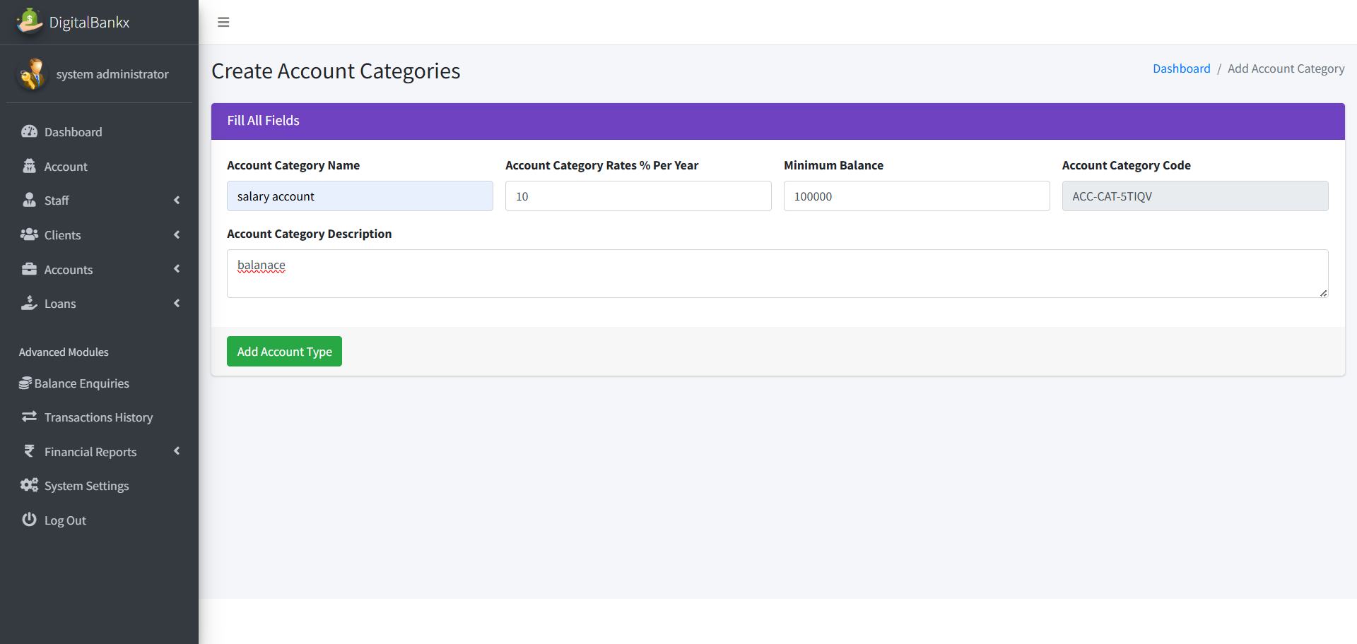
Create account :

Slide 66
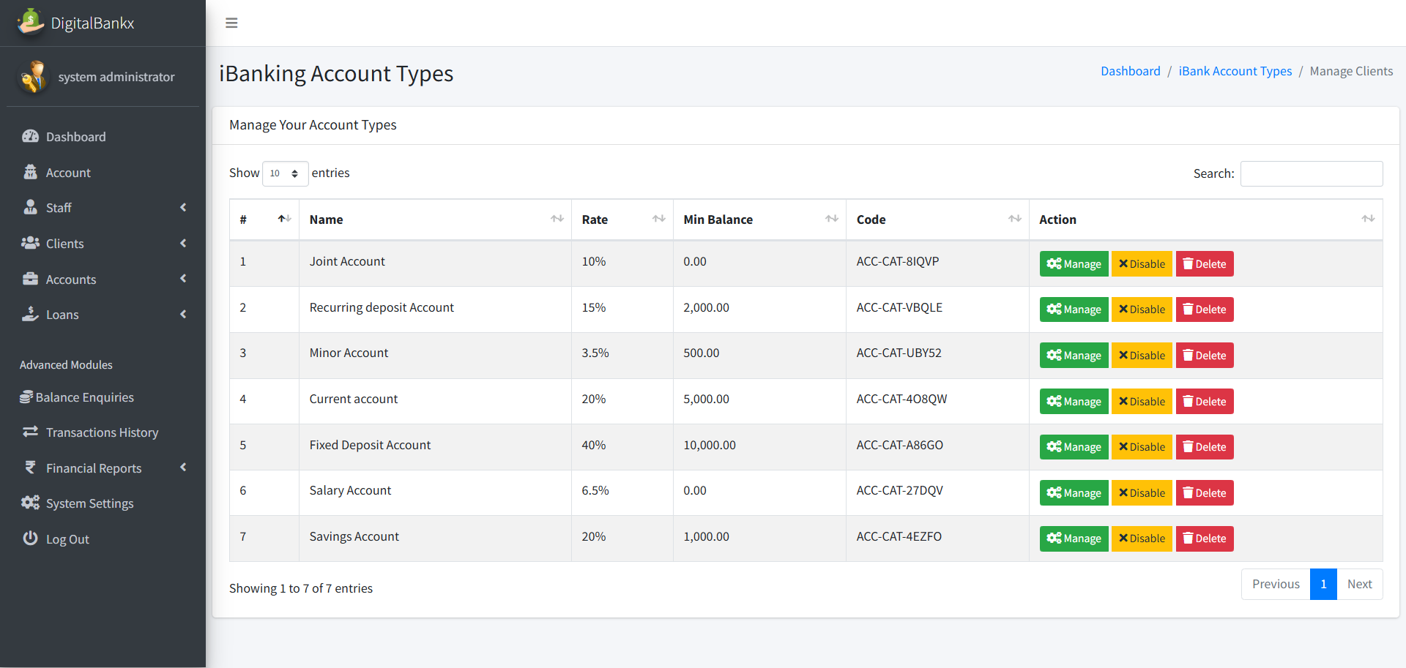
Manage a/c type

Slide 67
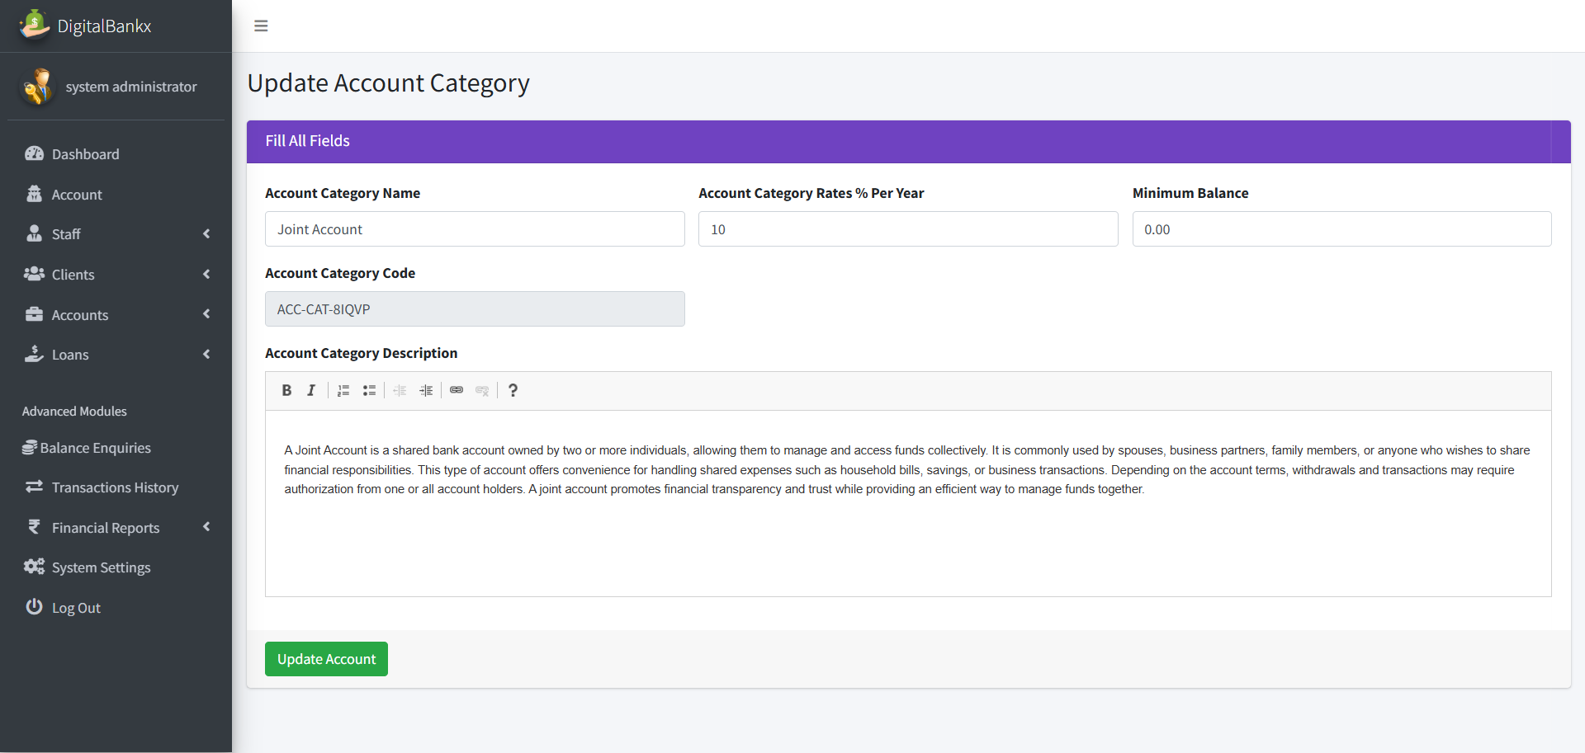
Update category name :

Slide 68
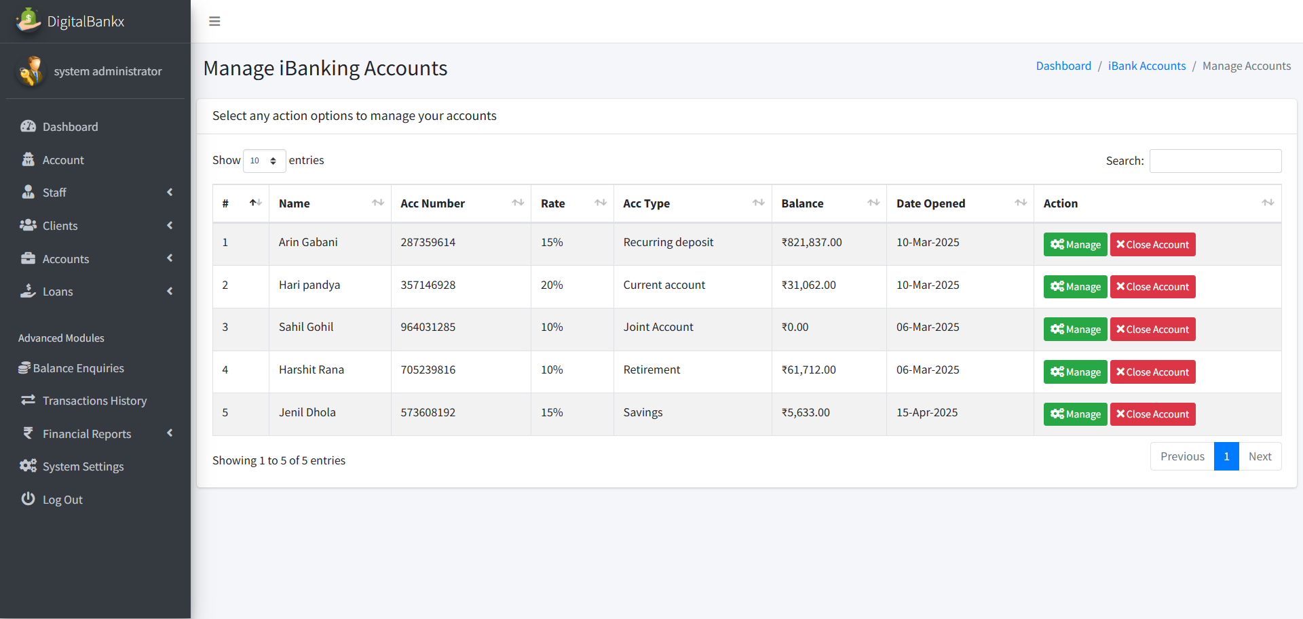
Manage a/c :

Slide 69
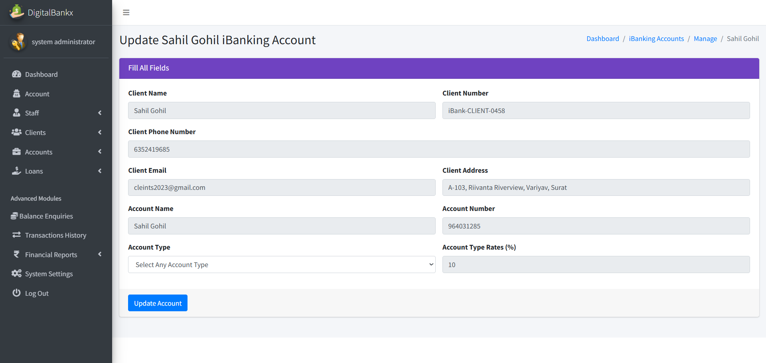
update a/c type

Slide 70
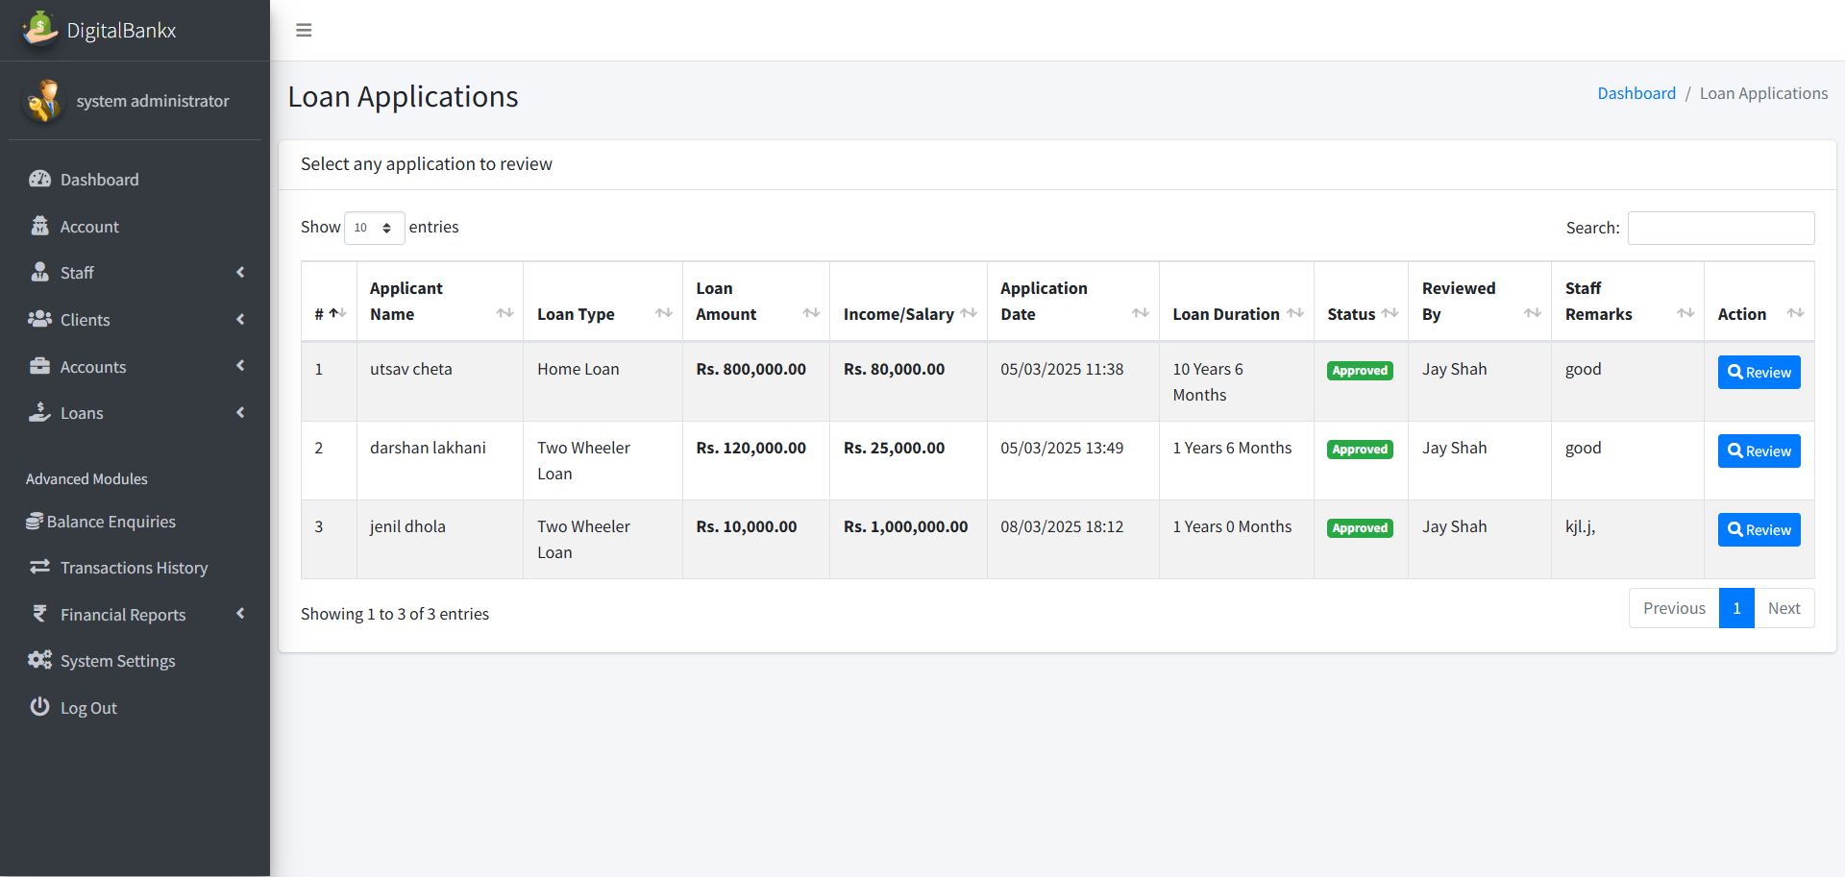
Loan application:

Slide 71
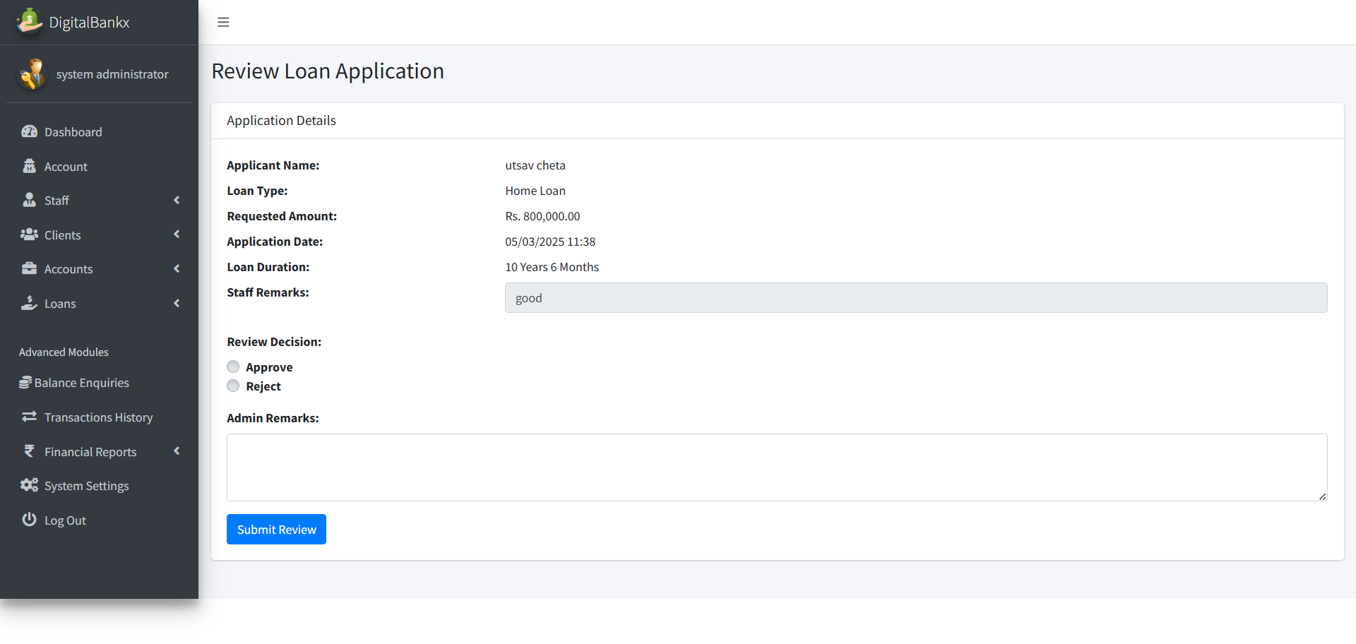
Review loan application:

Slide 72
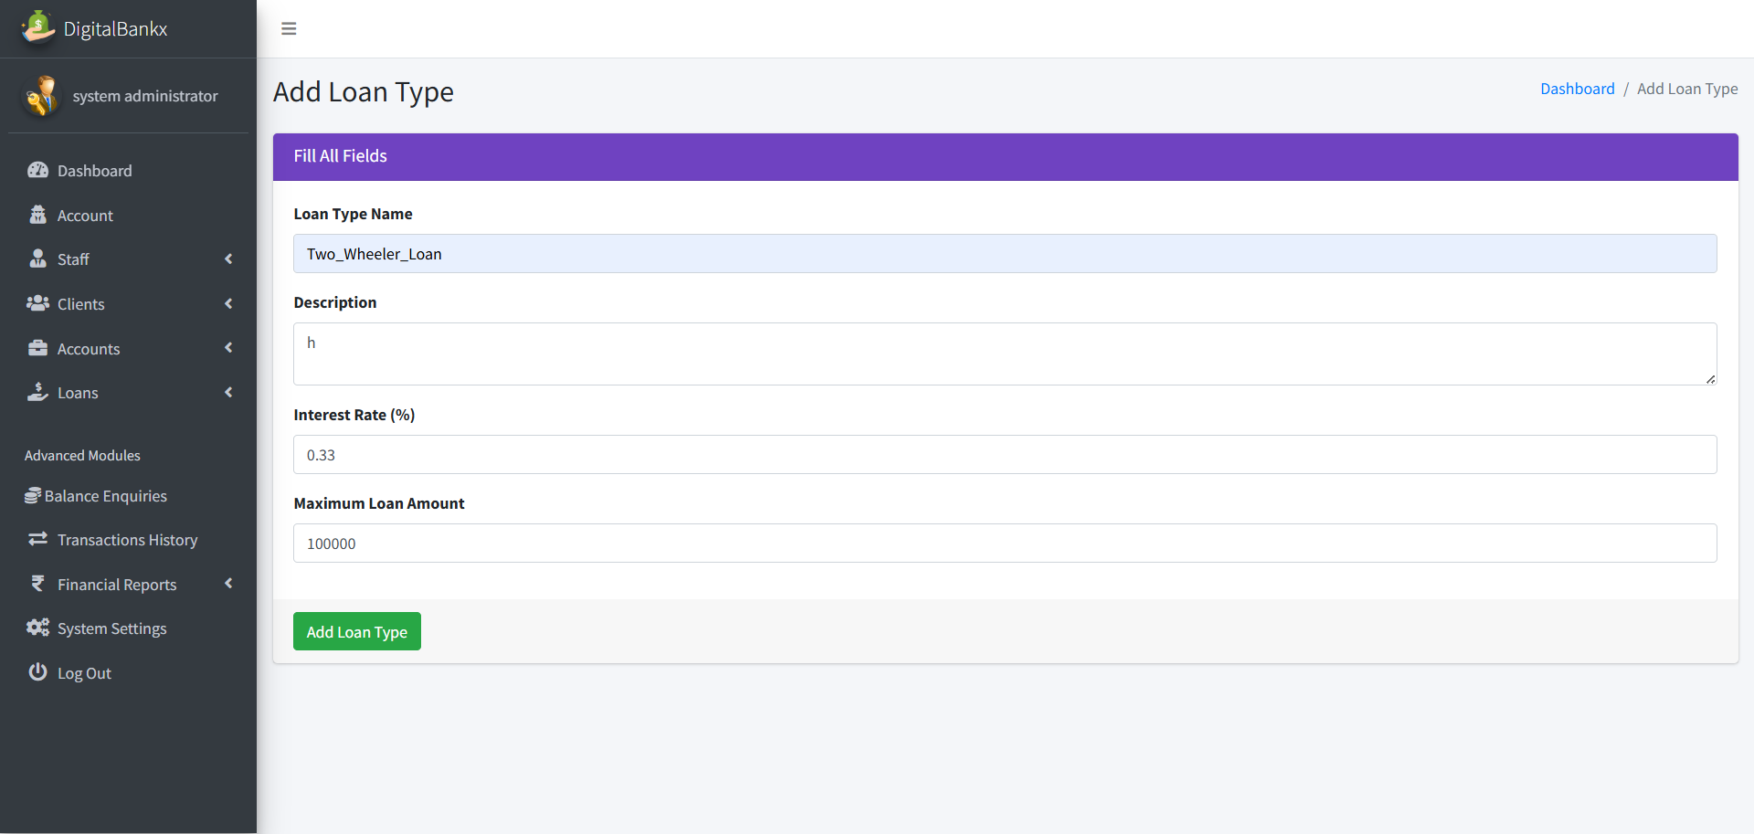
Add loan type

Slide 73
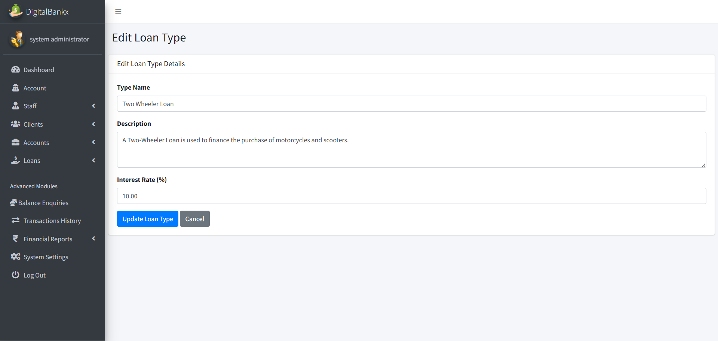
Edit loan type:

Slide 74
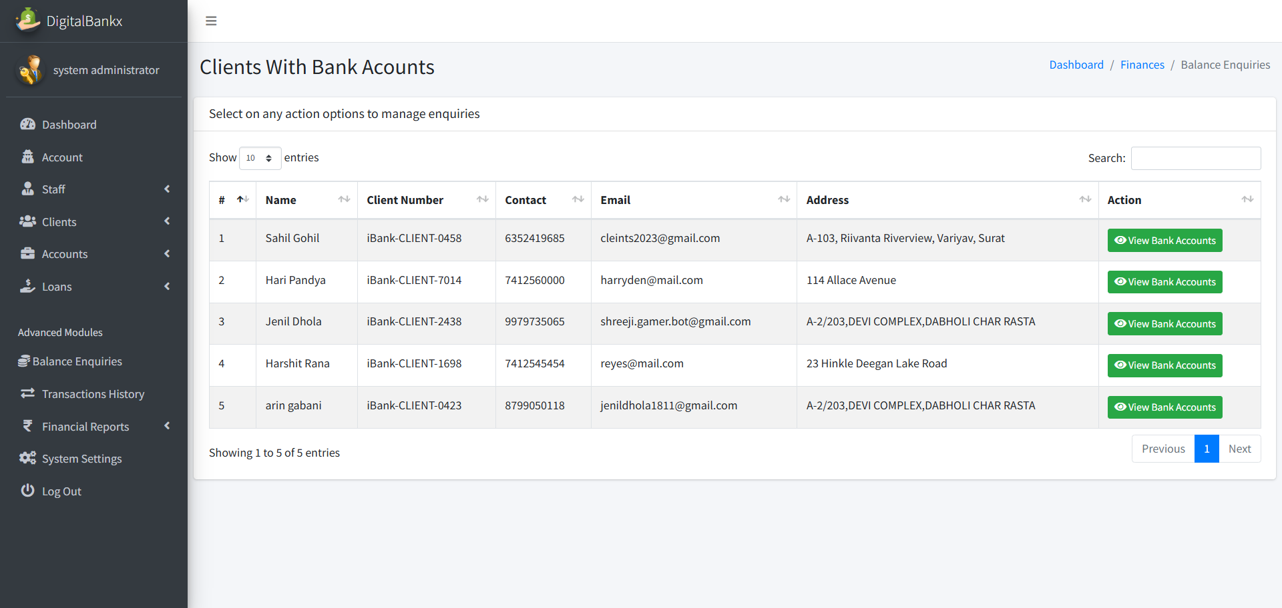
Balance enquiries:

Slide 75
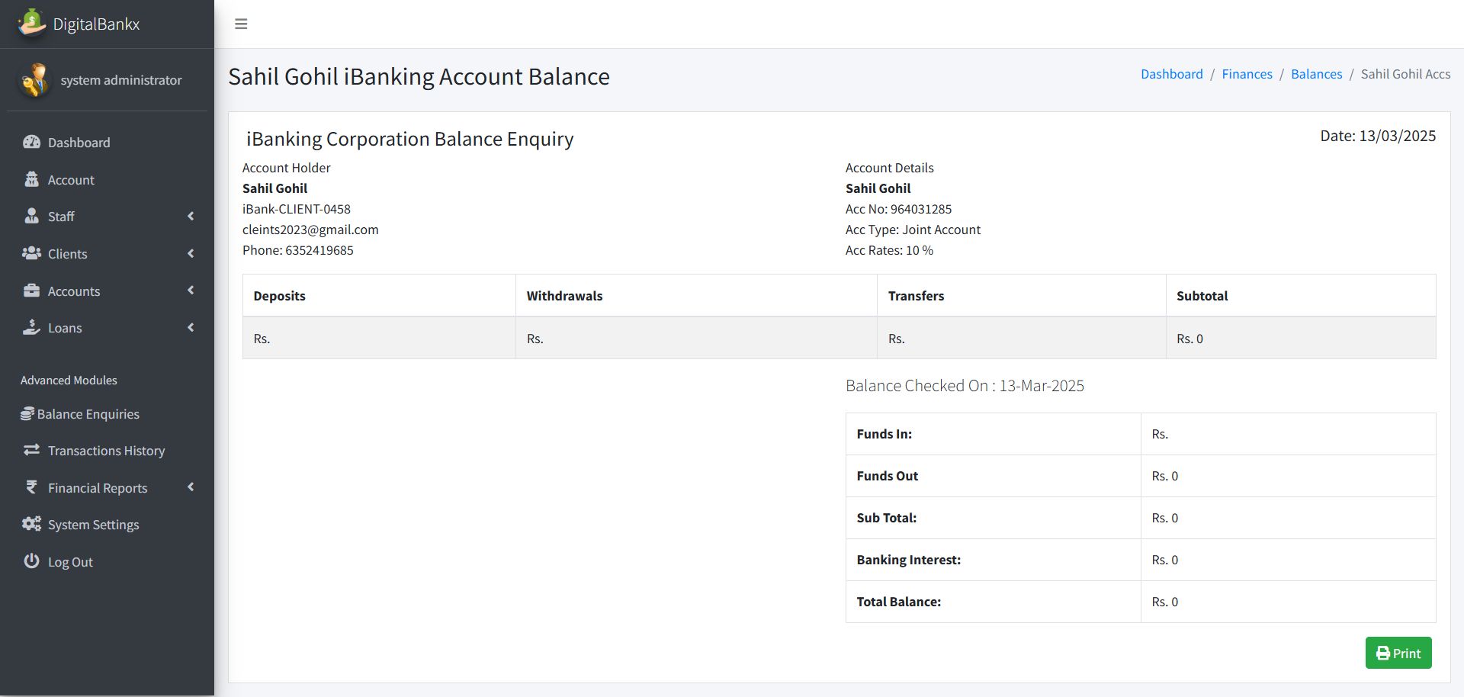
Check balance

Slide 76
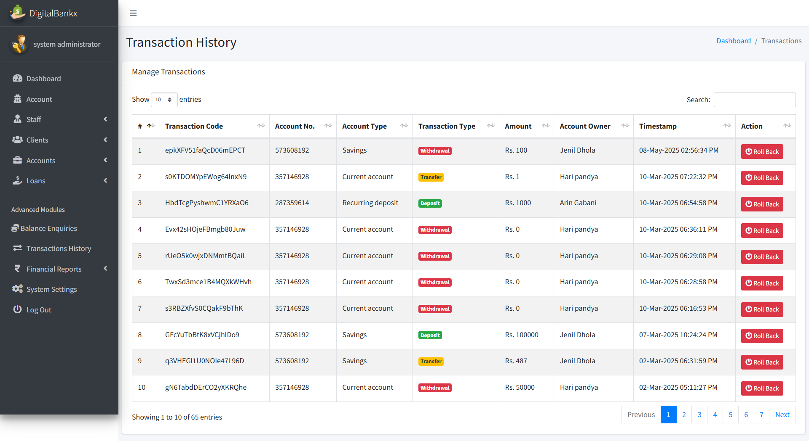
Transaction history :

Slide 77
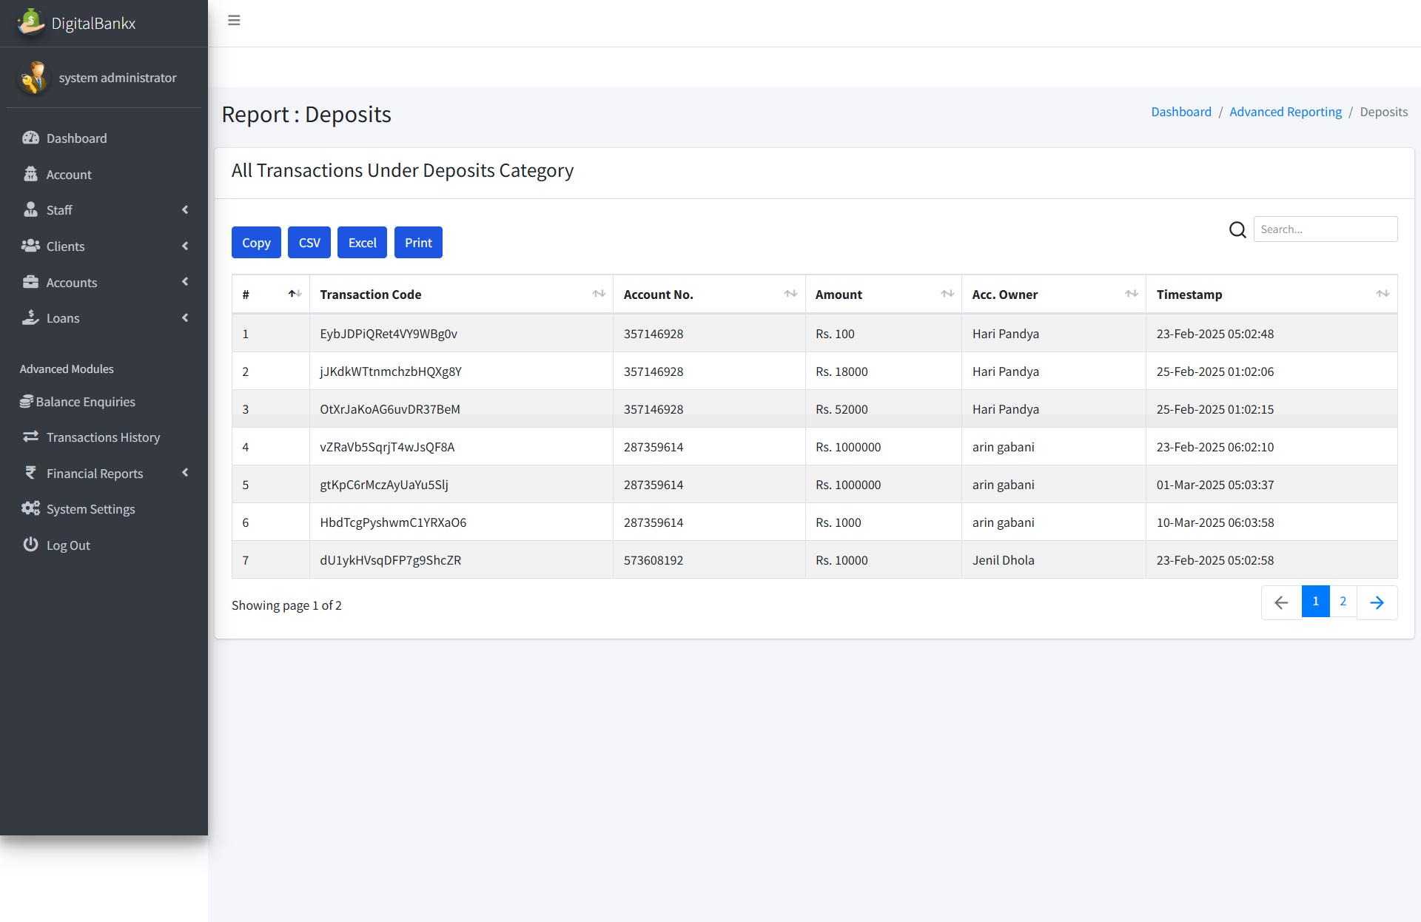
Deposite report

Slide 78
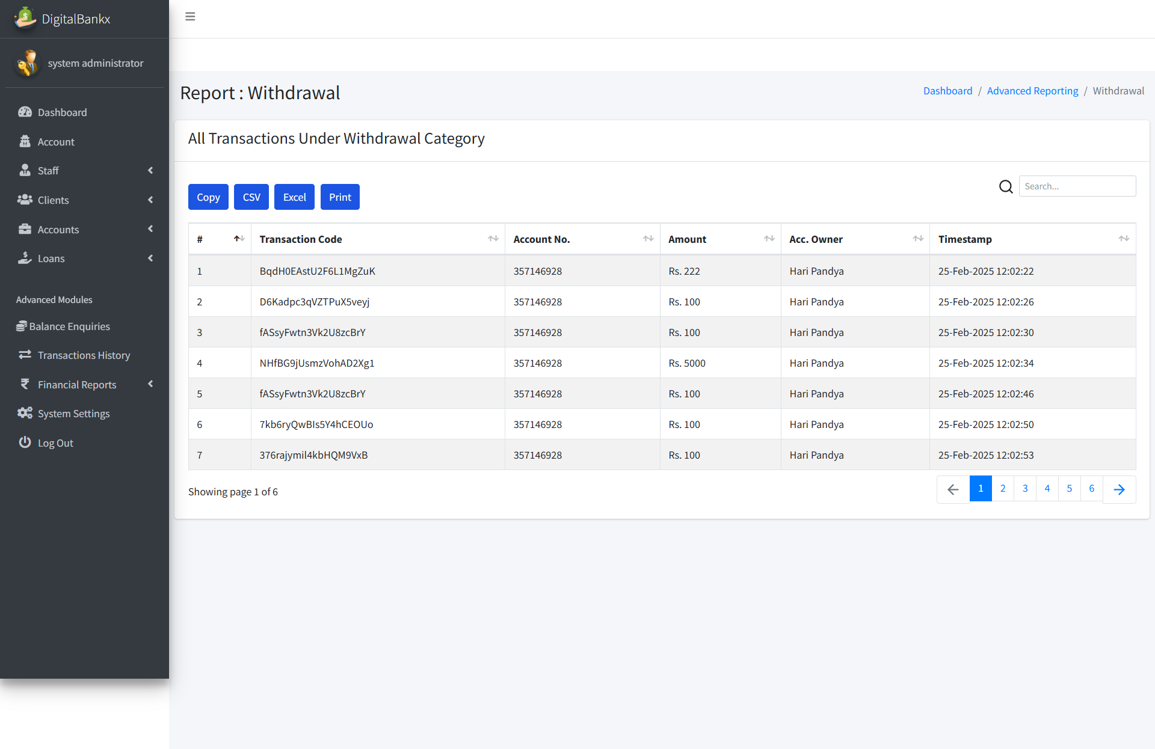
Withdrawal report:

Slide 79
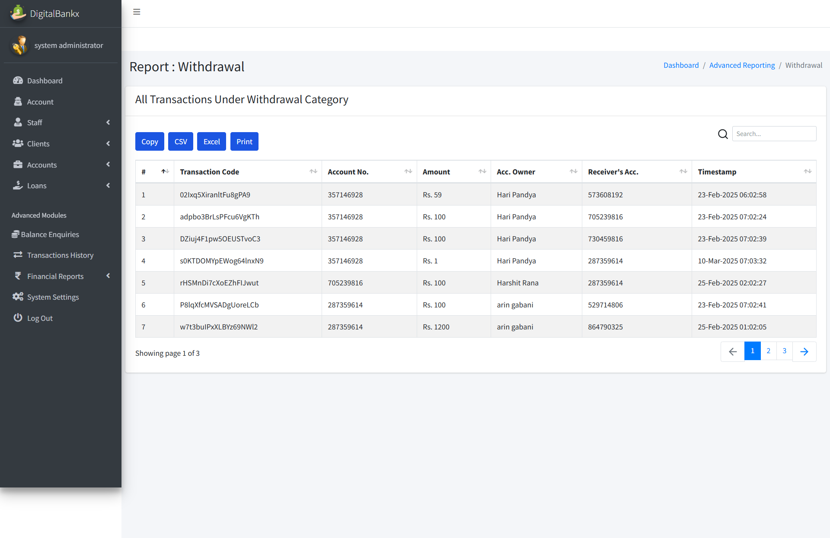
Transfer report

Slide 80
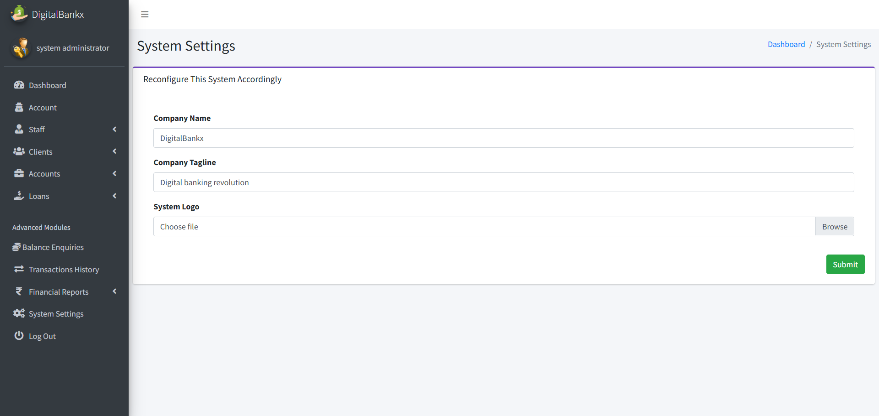
System setting :

Slide 81
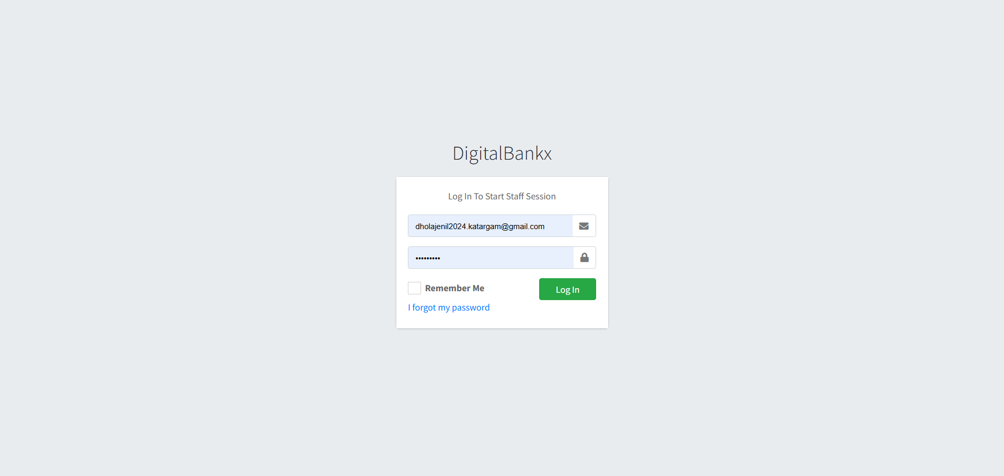
Staff login:

Slide 82
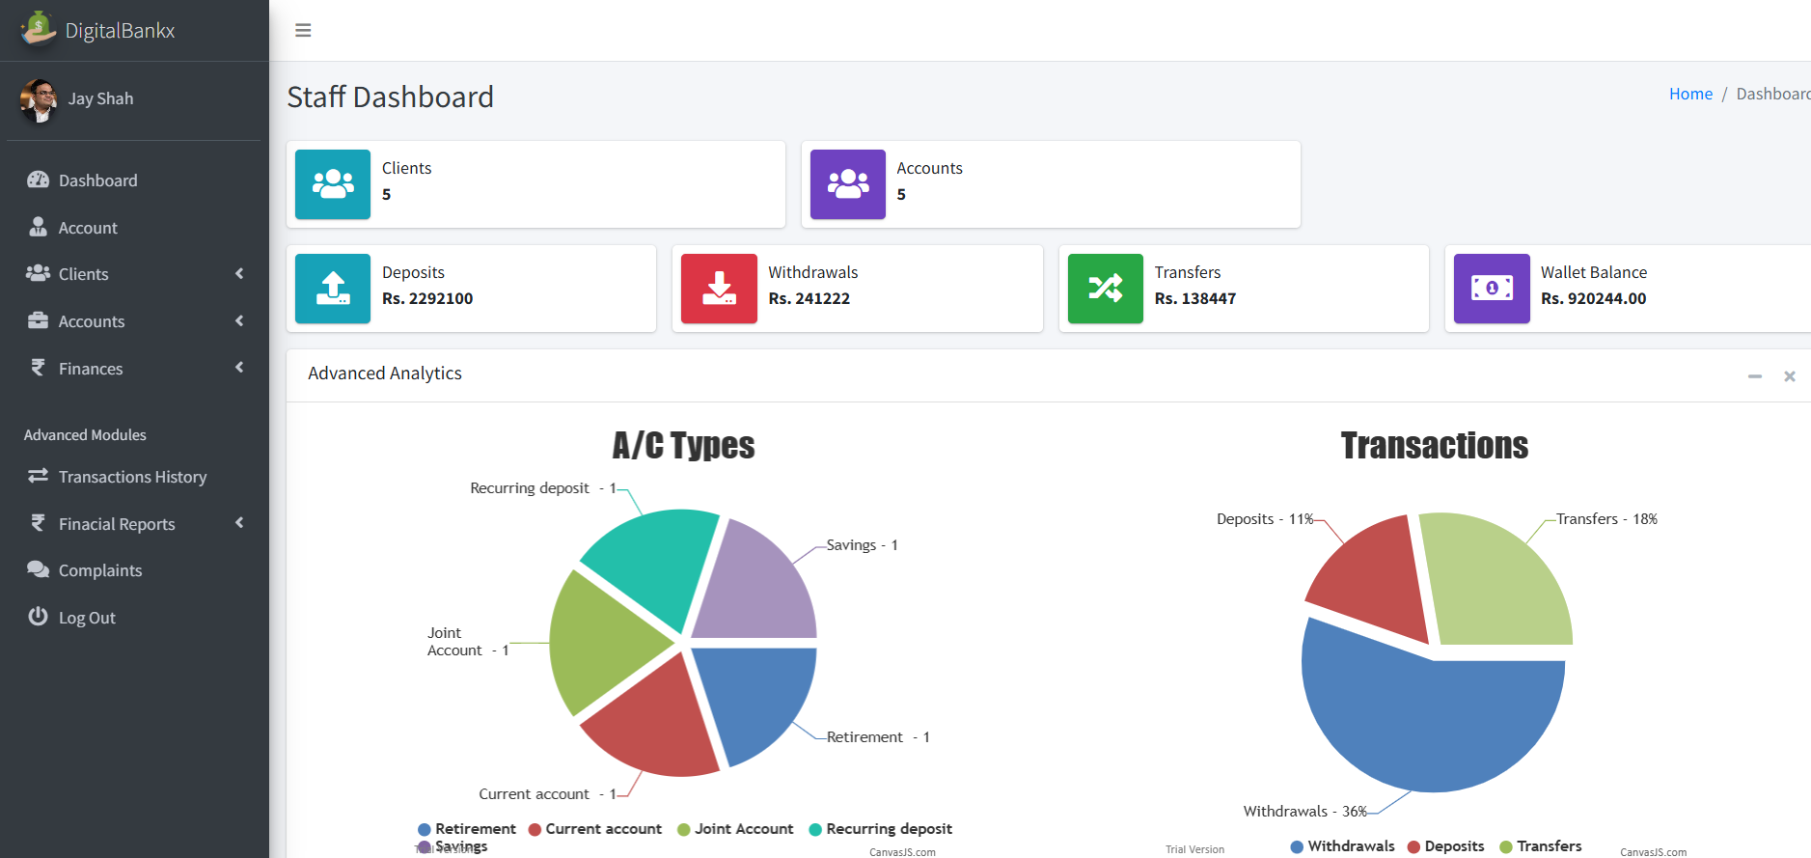
Staff dashbord :

Slide 83
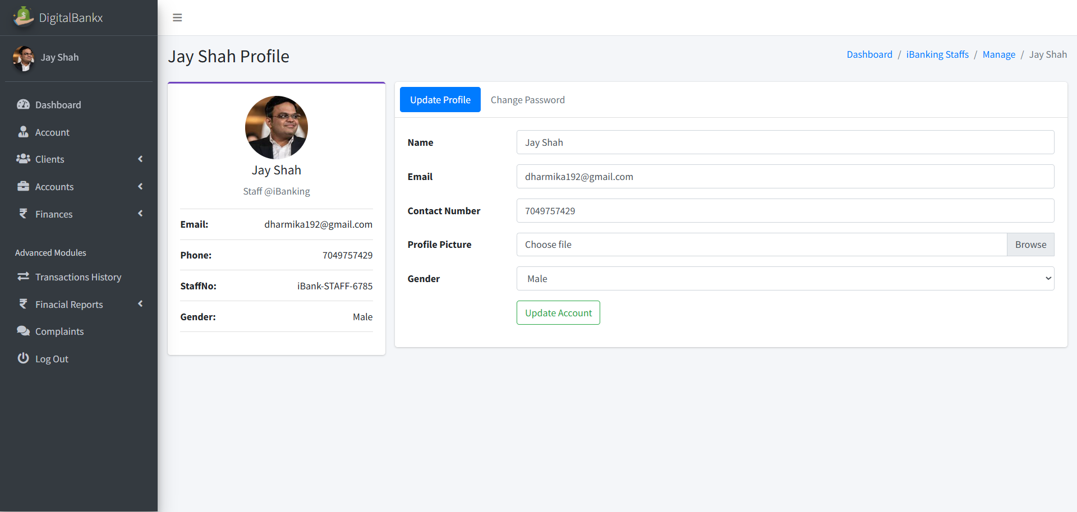
Staff account :

Slide 84
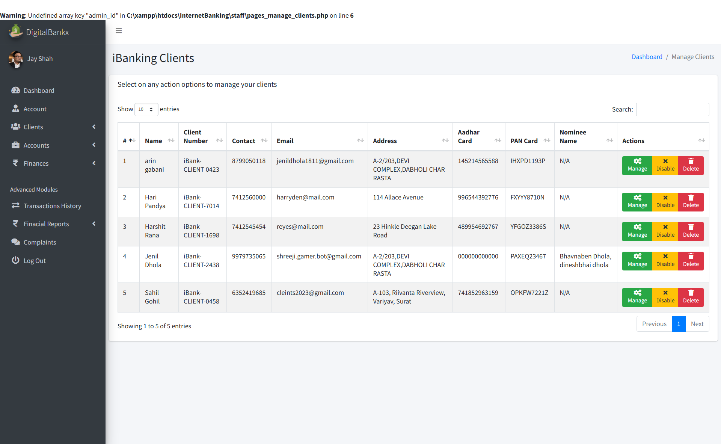
IB Clients:

Slide 85
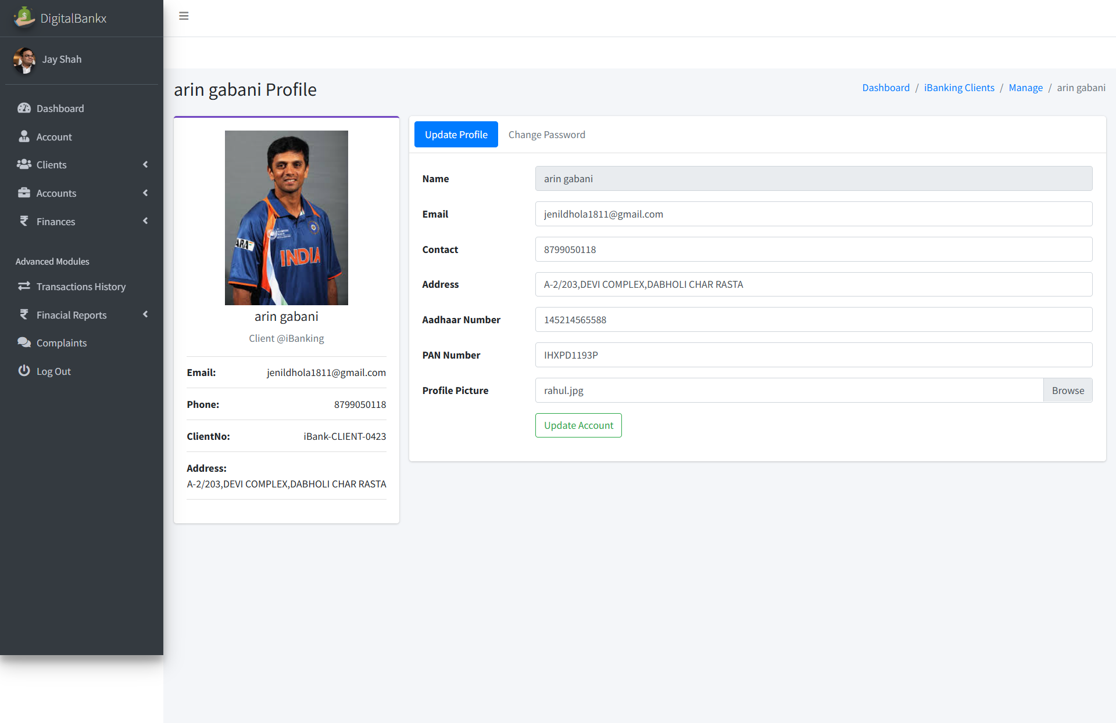
Manage client :

Slide 86
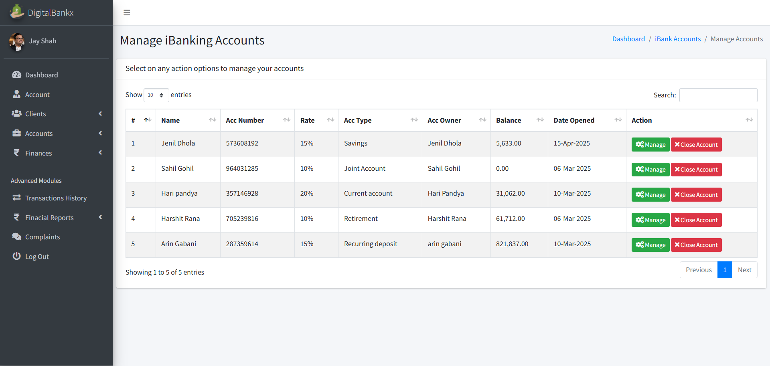
IB account :

Slide 87

Manage account

Slide 88

Deposite money:

Slide 89

Deposite money:

Slide 90

withdrawals:

Slide 91

Withdraw money:

Slide 92

Tranfers:

Slide 93

Transfer money :

Slide 94

Loan application:

Slide 95

Review loan application:

Slide 96

Balance Inquiries:

Slide 97

Check balance :

Slide 98

Transaction history :

Slide 99

Withdraw history :

Slide 100

Deposite history :

Slide 101
Transfer history :

Slide 102

Complains:

